Slide 1
1st Expedition Group Finances
Finances Information for New Section Scouters TREASURER: [Name]
(**Always check processes with your Group’s Commissioner & Treasurer as Section/Group operations may vary)
P&VS Edited May 2025

Slide 2
How to See Your Finances
Currently using an excel spreadsheet that I can share with those who would be required to have access
OR
Can create google sheets that will be accessible to all but with read-only access
OR
Open to other suggestions. Here is an example of the spreadsheet:

Slide 3
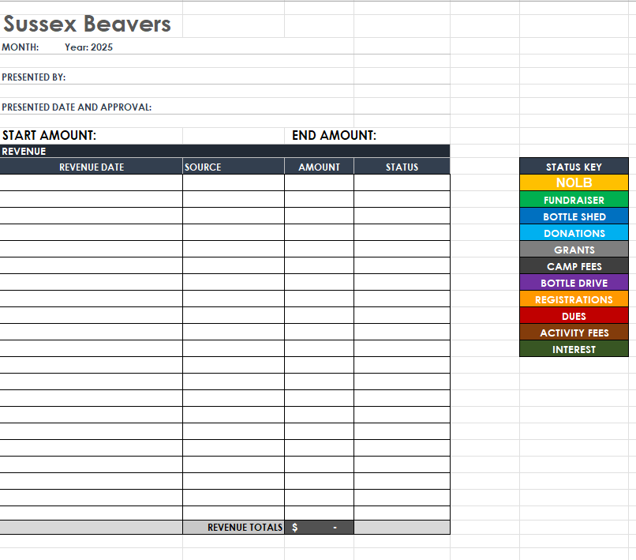

Slide 4
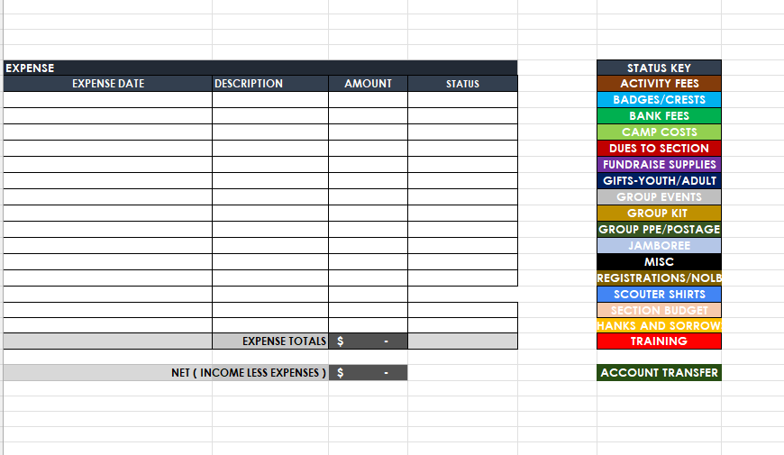

Slide 5
How to Submit Receipts:
Take a photo of the itemized receipt and include the following on the top of the receipts:
Person to be reimbursed
Section receipt pertains to
How much to be reimbursed
What the reimbursement is for
Then send an email to [email]@scouts.ca with the photo and a method of reimbursement (ex. phone number or email address for e-transfer)
Try to have ONLY Scouting purchases on the receipt if possible

Slide 6
BUDGETS
Scouting year is January-December
Think of the things you NEED to purchase for your Section:
Section specific badges, OAS, woggles, lodge/lair/patrol badges, SDG, language stripes, year stripes, Council and Group crests etc.
Think of the events and training you hope to have for the year:
Camps, sleepovers, day events
BP week, swim up/investiture, holiday party, Halloween party, Remembrance Day
Scouter development: First Aid, RiS, etc.
Other expenses, what you want/need
Fundraising expenses
Group/Section kit etc.
Money in = money out

Slide 7
How to Bring Money In?
National registration fee:
$25 per youth registered
Fundraising:
National has 3 campaigns each year: Scout Seeds in late winter/early spring, Scout Popcorn in the fall and Apple Day in October
Sections/Groups can do their own fundraisers. Things to consider:
Who will co-ordinate it?
Who will take money/place orders/receive orders and hand out orders?
How will you inform the public/families about the fundraiser?
Dues:
Your decision to collect or not weekly dues (typically $1-2 per youth per meeting).

Slide 8
Why I May Not Respond Immediately:
[Personal Limitations can be listed here or this slide can be removed entirely. Here are some sample personal reasons below]
I have a family, and am a mom of 3 young children
I work full-time from Monday to Friday
I am the Group Commissioner of 1st Expedition Scout Group
I am the Secretary of a local FORGE group
I am the Contact Scouter for 1st Expedition Scout Troop
I am the Treasurer of 2nd Expedition Group
I am a Guider and Treasurer with the Girl Guides
We all live busy lives but are doing this because it is an amazing organization to be a part of!

Slide 9
THANK YOU
Thank you for taking on this journey to becoming a Scouter
This may seem overwhelming now, but things will become less stressful as time goes on
Ask any questions anytime!

