Slide 1
New Scouter Onboarding Info Session

Slide 2
Agenda
Welcome!
Session Objectives
Become a Volunteer in 30 Days or Less!
Benefits of Volunteering
Questions and Answers
Adjournment

Slide 3
What this Workshop is About
Objectives:
Empower applicants with the information you need for a smooth, quick, and headache free onboarding experience
Introduce you to the key players you’d rely on and engage with

Slide 4

Why Volunteer?
You want to spend more time with your kids
You want to spend more time in nature
You have a lot of know-how to share (everyone does!)
You care about youth and want to make an impact
You want to have fun!
You want to contribute to your community

Slide 5
Why Volunteer with Scouts Canada?
Largest youth movement in the world
Opportunities to travel
Great experiences to add to your resume
Build a network
Development and skill-building opportunities
LOTS of variety

Slide 6
A Note About Language
Applicant: person who has begun the onboarding process
Pending: in the process of completing onboarding
Active: completed onboarding successfully, can work with youth
Element: any of the items that an applicant needs to complete in order to become an Active member of our movement.
Scouter: Scouts Canada volunteer
(we no longer call our volunteers “Leaders”, as youth are the leaders of our organization!)

Slide 7
A Note About Language
Section: A cohort of youth belonging to a larger group. Example: Beavers, Cubs, Scouts.
Group: A committee-run entity who administers and facilitates Scouting in their community. Sections belong to Groups.
You will belong to a Group Committee or a Section ☺
i.e. “2nd Expedition Cub Pack”, “2nd Expedition Scout Group”

Slide 8
A Note About Language
Youth Sections are defined by age.
Beaver Colony 5–7 years-old
Cub Pack 8-10 years-old
Scout Troop 11-14 years-old
Venturer Company 15-17 years- old
Rover Crews 18-26 years-old
Notes:
While not super necessary for onboarding it does make life a little easier when you know what we mean when we say these words, and you will likely encounter them as you begin onboarding

Slide 9
A Note About Language
Scouts is the general term for youth members, and the exact term for youth in a Scout Troop (this is all historically-based).
We have Beaver Scouts, Cubs Scouts, Scouts, Venturer Scouts, and Rover Scouts.
Volunteers are known as Scouters, NOT leaders

Slide 10
A Culture of Safety
Volunteer onboarding is part of our safety culture.
Adults appointed to positions of authority with youth undergo a vetting process. This process is designed to ensure that volunteers are suitable to occupy a position of trust.
Volunteer Screening Procedure

Slide 11
A Culture of Safety
Onboarding also introduces new volunteers to our Code of Conduct and youth protection training which enables them to begin their journey as a Scouter with safety at top of mind.

Slide 12
Key Players in Your Onboarding Journey
Group Commissioner (GC): Head Scouter for your Group, who is responsible for ensuring a safe environment, provides oversight, guidance, and support.
Group Committee: volunteers who manage administrative functions like finances, recruitment, fundraising, etc.
Scouting Relationship Manager (SRM) OR Group Support Scouter (GSS): supports Groups directly and assists with onboarding where needed. Helps strategize and problem- solve.
Member Services Associates (MSA): the team behind the email registration@scouts.ca
Section Scouters: other members of the Section volunteer team you are joining (unless you’re joining the Committee)

Slide 13

Ready? Let’s Go!

Slide 14

Day 0
Welcome! We hear you’re interested in becoming a volunteer with Scouts Canada.
Links: How to Register as a Volunteer
Youth Volunteers
Becoming Volunteer Ready

Slide 15
Day 0
Prepare 5 references
Your references will be notified by a third-party service called “Backcheck” from Sterling Check.
Let your references know they will receive an email from Backcheck regarding your reference check and to kindly check their junk mail.
Notes:
Now before you start the application, please have this information ready so you can input it right away. Otherwise we do have to add them manually, which just adds an extra step may delay your activation

Slide 16
Day 0
Prepare 5 references – who?
a. A co-worker or workplace supervisor
b. If you’ve volunteered with another youth-serving organization, someone from the organization.
c. Others (non-related) who can attest to the person’s character
d. At least two references who have known you for five years or more.
NB: Applicants and references may not be related by blood, adoption, or marital status.
Notes:
Now before you start the application, please have this information ready so you can input it right away. Otherwise we do have to add them manually, which just adds an extra step may delay your activation.
And another tip: please share personal email addresses of your referees vs work emails, since some workplaces have firewalls that may block the backcheck email from being delivered. This is especially so with government of Canada email addresses.

Slide 17
Day 1
Begin your application by logging into MyScouts.ca
You will only require one log-in as a volunteer and a parent.
From your dashboard, click the blue “Register as Volunteer” button.

Slide 18
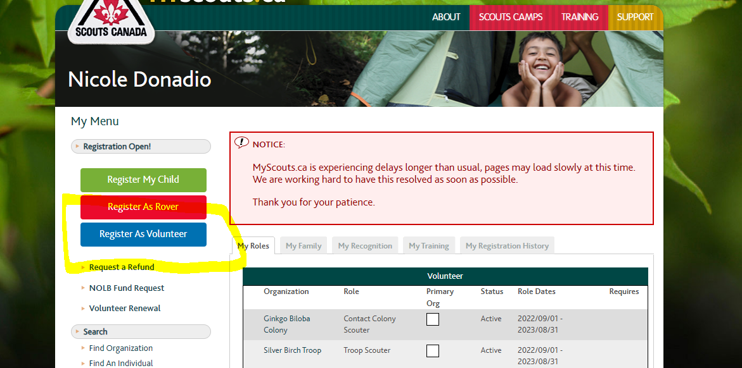
Day 1

Slide 19
Day 1
Signed Code of Conduct
Entered 5 references
You may begin Scouting Fundamentals training online in the David Huestis Learning Centre

Slide 20
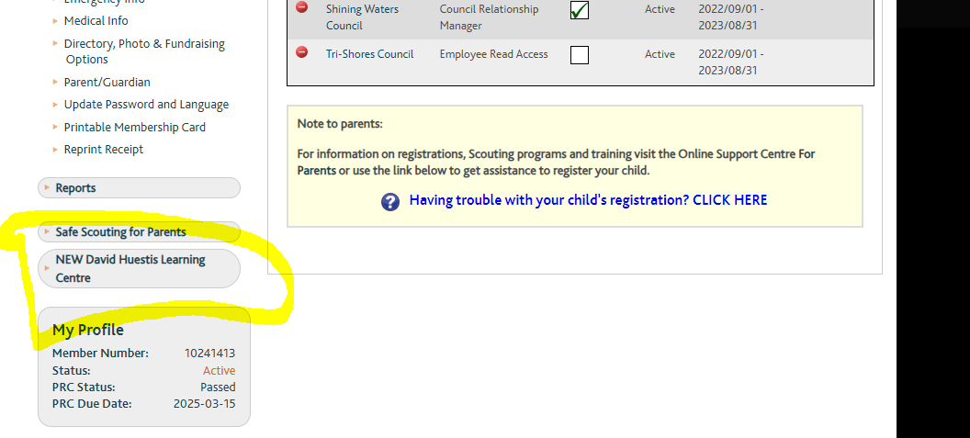
Scouting Fundamentals

Slide 21
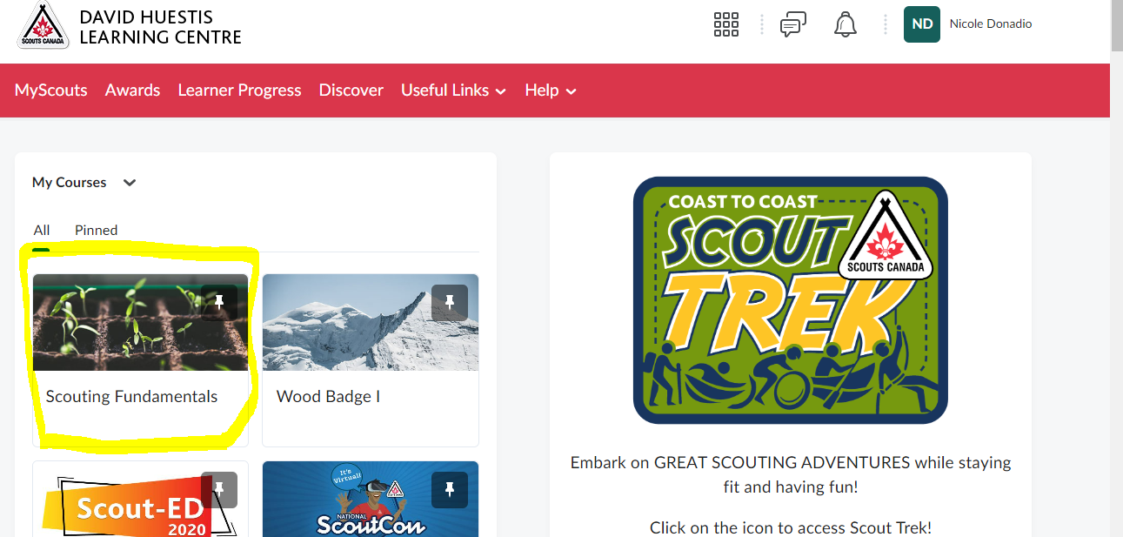
Scouting Fundamentals

Slide 22
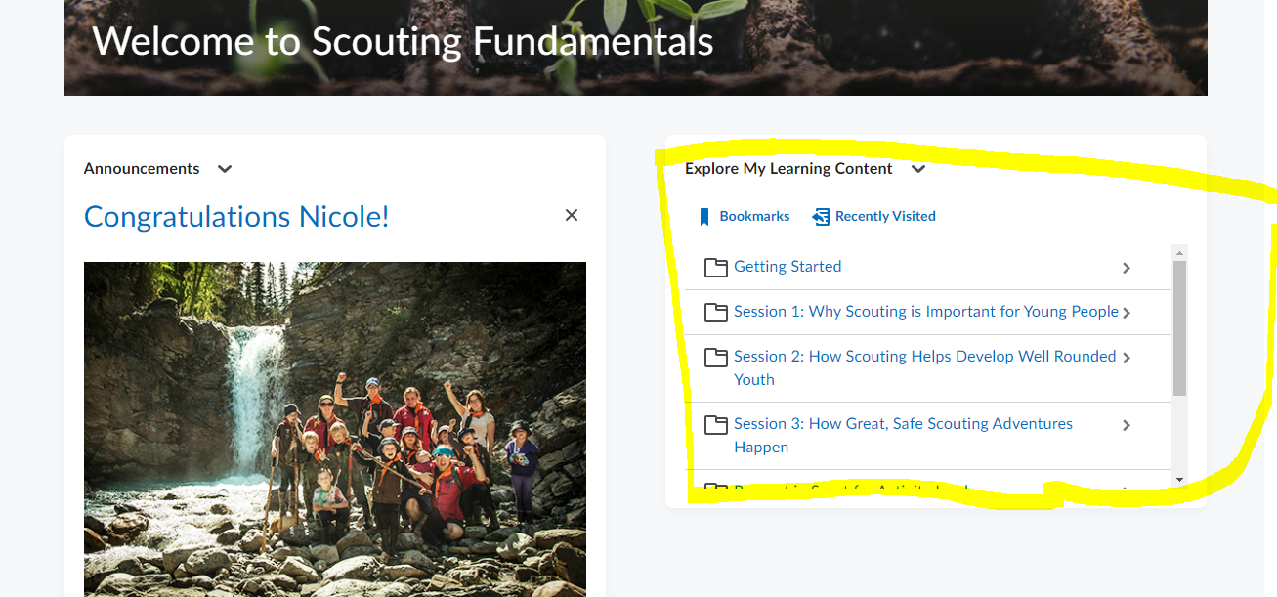
Scouting Fundamentals

Slide 23
Scouting Fundamentals
6 Modules
Session 1: Why Scouting is Important for Young People (15 mins) Session 2: How Scouting Develops Well Rounded Youth (30 mins) Session 3: Great Safe Scouting Adventures (20 mins) Session 4: Respect in Sport for Activity Leaders (180 mins) Respect in Sport for Activity Leaders FAQ Session 5: How you can help Scouting reach more young people (55 mins) Session 6: What comes next? (8 mins)
Total: 5 hours and 13 minutes

Slide 24
Acronyms in MyScouts
Int: Interview
Ref: References
PRC/VSS: Police Record Check and Vulnerable Sector Screening
SF: Scouting Fundamentals
RiS: Respect in Sport for Activity Leaders (part of SF)
Acc: Accessibility Training (part of SF)
CoC: Code of Conduct
GCap: Group Commissioner Approval
Cap: Council Approval

Slide 25
First 72 hours
Your Group Commissioner, Onboarding Manager, and Contact Scouter receives a notification email that you’ve applied.
From here, expect to hear from them about scheduling an interview and obtaining a Police Record Check and Vulnerable Sector Screening proof of volunteerism letter.
Notes:
While you can absolutely get started on training right away, two items you will need assistance from your group with will be scheduling your interview. If you don’t hear from them in about 24-72 hours, please don’t hesitate to reach out. If you need assistance, you can also reach out to the scouting relationship manager assigned to your group.

Slide 26

Week 2
Apply for PRC/VSS
Interview – scheduled or completed
Continue online training modules (including RiS)
References – in progress? Completed?

Slide 27
Week 3 and 4
Scouting Fundamentals completed
PRC submitted
Interview completed
References completed

Slide 28
Week 3 and 4
GCap completed by Group Commissioner
Cap – the last step – is granted by the Member Services Team once all other elements are completed

Slide 29

Celebrate!
Nice Work! You’ve completed your onboarding and can get started on great, safe, Scouting Adventures! You may now:
Work directly with youth members
Count towards ratio and the two-Scouter rule
Wear the Scouts Canada uniform (red shirt)
Be invested in your Group (get your Group Neckerchief)
And most importantly, HAVE FUN!

Slide 30
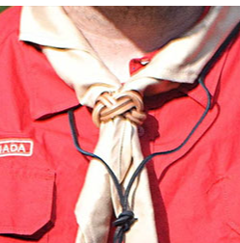
Next Steps in your Journey
Start Scouter Development Milestone, Wood Badge 1 for the Canadian Path
Online modules complemented with in-person, hands-on experience in your own Section
Completed within 365 days of your registration
Awarded Woggle once completed

Slide 31

Question and Answers

Slide 32

Thank You!

