Slide 1
Welcome Parents! [Group] Parent-Info Night

Slide 2
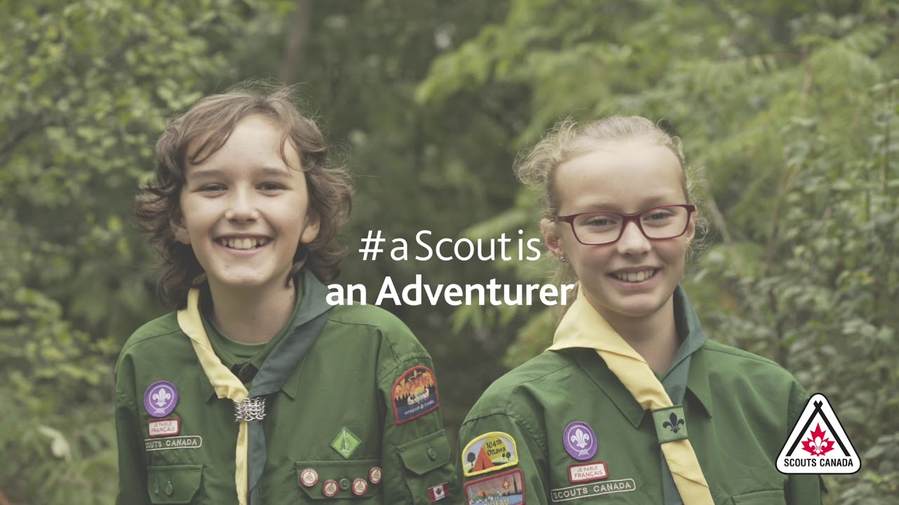
A Scout is…
Capable, confident, a leader, a friend, an adventurer and an environmental steward

Slide 3
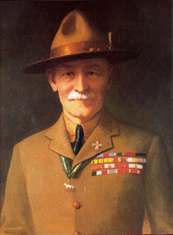
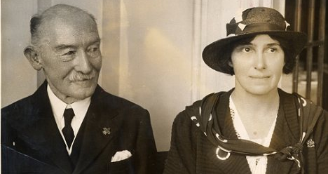
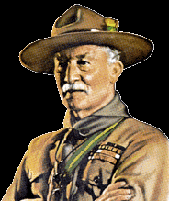
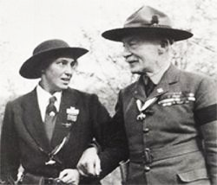
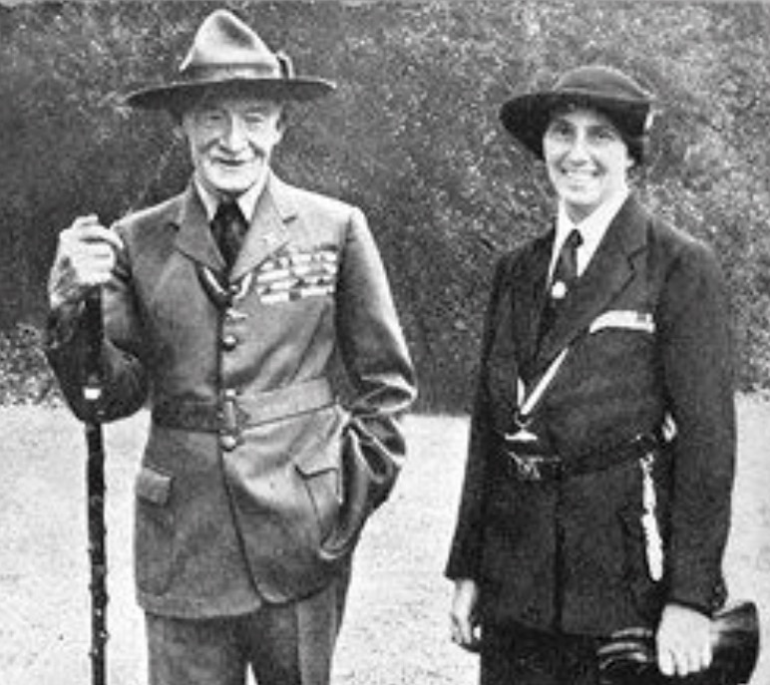
A Brief History of Scouting
In 1900, Baden-Powell became a national hero in Britain for his 217-day defense in the South African War.
Soon after, Aids to Scouting, a military field manual he had written for British soldiers in 1899, caught on with a younger audience. Boys loved the lessons on tracking and observation and organized elaborate games using the book.
Hearing this, Baden-Powell decided to write a non-military field manual for adolescents that would also emphasize the importance of morality and good deeds.
First, however, he decided to try out some of his ideas on an actual group of boys. On July 25, 1907, he took a group of 21 adolescents to Brownsea Island in Dorsetshire where they set up camp for 2 weeks. With the aid of other instructors, he taught the boys about camping, observation, deduction, woodcraft, boating, lifesaving, patriotism, and chivalry. Many of these lessons were learned through inventive games that were very popular with the boys. The first Boy Scouts meeting was a great success.
With the success of Scouting for Boys, Baden-Powell set up a central Boy Scouts office, which registered new Scouts and designed a uniform. By the end of 1908, there were 60,000 Boy Scouts, and troops began springing up in British Commonwealth countries across the globe.
The Canadian General Council of the Boy Scout Association was incorporated by an act of the Canadian Parliament on June 12, 1914.
In 1998 Scouting in Canada went co-ed. In 2007, our Centennial Year, our name was officially changed by an act of Parliament to Scouts Canada. Today, Scouts Canada is a highly diverse organization with over 100,000 members nationwide representing every faith and culture. Scouts Canada offers programming in more than 19 languages reflecting Canada's multicultural landscape and communities.
Scout-Guide Week
Every February in the week that includes the 22nd, we hold Scout-Guide week, in celebration of our Founder, Baden Powell. Him and his wife, Olave Baden-Powell, shared the same birthday, Feb 22nd. He was born in 1857, she was born in 1889.
Scout-Guide week is often celebrated with family banquets, special event, award ceremonies or crafts, games and stories about our founder and the beginning of scouting.
Our Left hand shake
When Baden-Powell met the Ashanti Warriors, he saluted them with his right hand, but the Ashanti chiefs offered their left hands and said, "In our land only the bravest of the brave shake hands with the left hand, because to do so we must drop our shields and our protection.“
Today when 2 Scouting members greet each other, we make the scouting sign with our right hands and shake hands with the left hands as a sign of respect and peace.

Slide 4
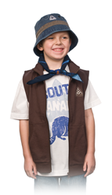
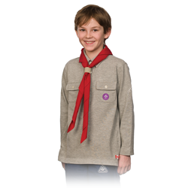
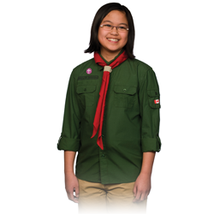
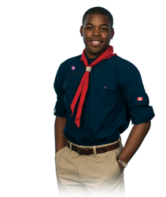
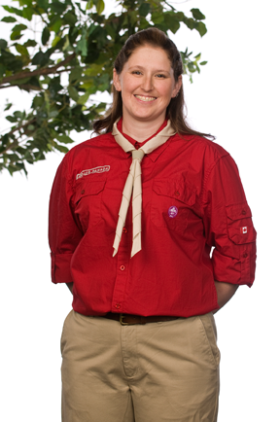
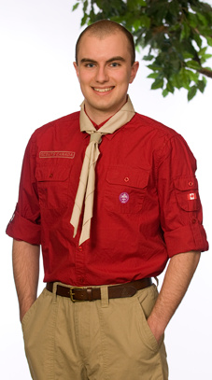
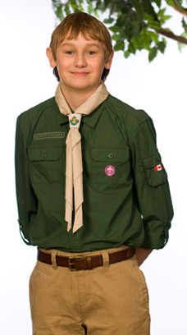
Scouting is for boys and girls ages 5 to 26
Beaver Scouts – ages 5 to 7
Cub Scouts – ages 8 to 10
Scouts – ages 11 to 14 (15)
Venturer Scouts – ages 15 to 18
Rover Scouts – ages 18 to 26
Volunteers – ages 14 and up

Slide 5
Scouting Terms 101
Scouter – A volunteer in the organization who has completed all screening and training. Although all registered volunteers technically carry the title “scouter”, its most often used for those who work at the Section level with youth.
Group Committee Member – A volunteer who holds a role with the committee that assists the sections within their group. i.e. treasurer, Group Commissioner, fundraiser, administrator, sponsor liaison, etc.
Leader – the title we use for youth members who are in a leadership role such as, patrol leader, youth commissioner, peer mentors, etc.
Rainbow, Tic Tac, Akela, Bagheera – Historically our Beaver and Cub Scouters had “nick names” that were based on the folklore of those programs. Cubs is based on “the Jungle Book” and Beavers is based on the book “Friends of the Forest”. The nick names are characters in these stories.
Necker – The term we use for the “Scarves” that our members wear. These are different colours which tell us what group the member is with.
Woggle – The holder we wear around our neckers.
Beaveree, Cuboree, Jamboree, Camporee – A large gathering of members from multiple groups.
Scouts' Own - A gathering of Scouts held to help them develop their spirituality and a fuller understanding of the Scout Law. Many groups will include a Scouts’ Own in their closing after each meeting.

Slide 6
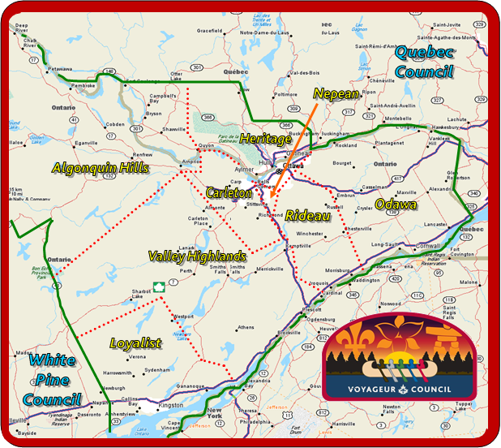
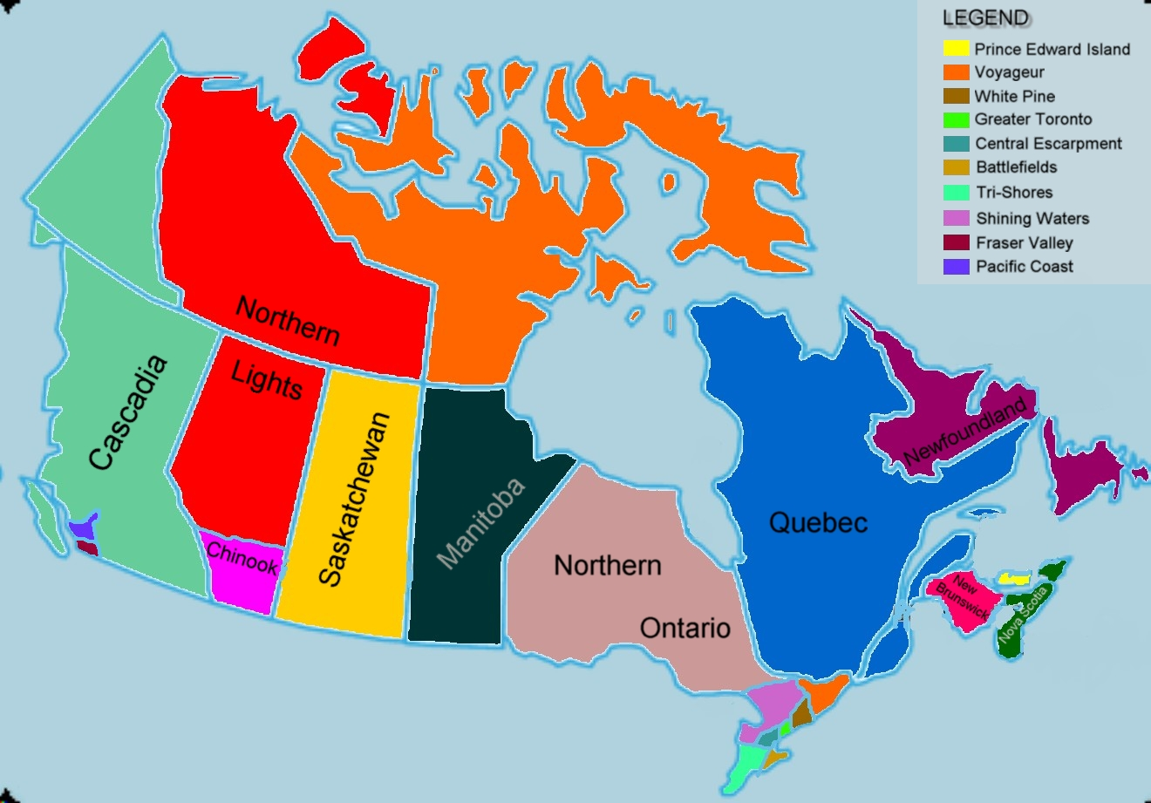
Where are we?
20 Councils Across Canada
Voyageur Council

Slide 7
Program and what can you expect?
Badges and Awards
Badges and awards are for every section in an age-appropriate level.
Badges are in 2 categories, Outdoor Adventure Skills (OAS) and Personal Achievement (PAB).
Outdoor Adventure Skills
There are 9 skills and 9 levels for each skill. Youth have their entire time in Scouting, as a participant, to accomplish the level highest possible for them.
Personal Achievement Badges
These are badges are designed to allow youth to explore and expand skills and knowledge in areas that are of particular interest to them. In The Canadian Path, Personal Achievement badges are strictly optional. There are 16 PA badges per section. Requirements for these badges are laid out for each child by the child, parent/guardian and Scouter. This is done so that the youth can decide what is “challenging” for them as an individual.
Program Areas
There are 6 program areas:
Leadership
Healthy, Active Living
Environment and Outdoors
Citizenship
Creative Expression
Beliefs and Values
Youth-Led
We will ask every child
“what do you like to do?”
“What adventures would you like to go on?”
“What would you like to learn this year?”
“Is there anything you would like to teach your fellow Scouts?”
Plan, Do, Review
We teach our youth AND Scouters to plan their activity, carry out the plan together, and then review the activity and the plan to see what worked, what didn’t and how they can improve next time.

Slide 8
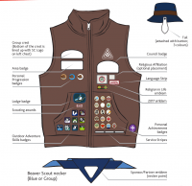
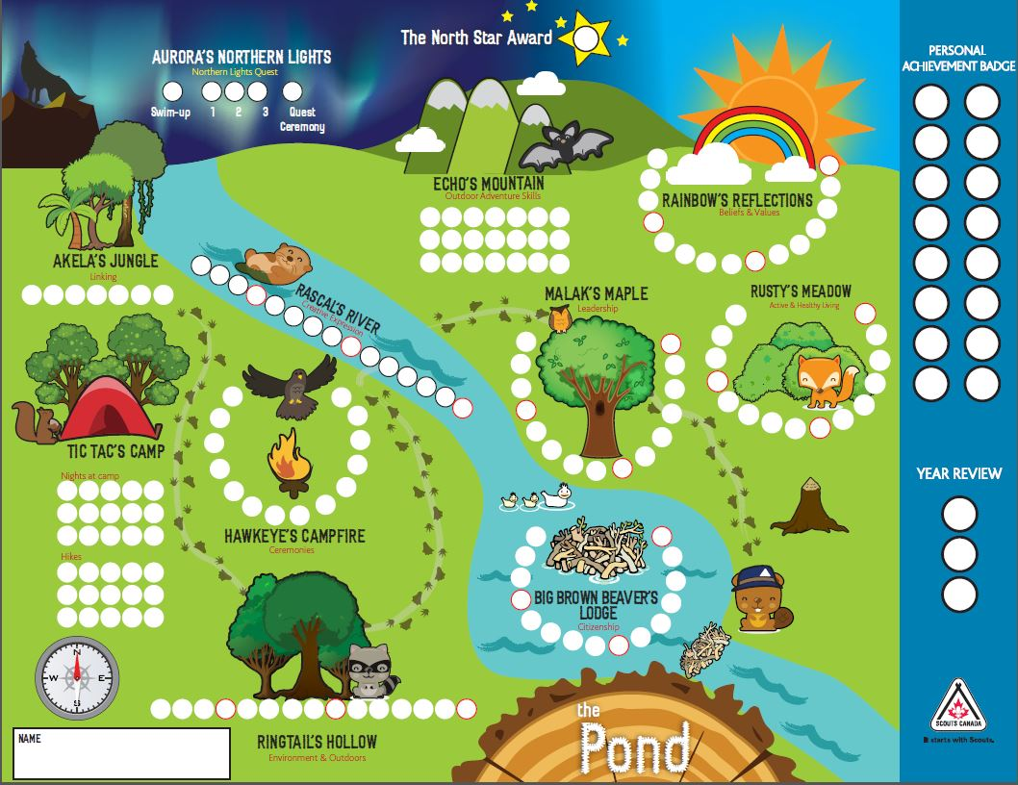
Promise:
I promise to love God and help take care of the world
Alternative:
I promise to be kind and to help take care of the world.
Law:
A Beaver has fun, works hard and helps family and friends.
Motto:
Sharing, Sharing, Sharing.
We teach sharing, environment, teamwork and introduce youth to Plan, Do, Review.
Your Beaver Scout is part of their group or Colony. Each Colony is broken up into small groups called lodges. Each lodge has an “elected” Beaver (usually 3rd year) to help them along with the Scouters.

Slide 9
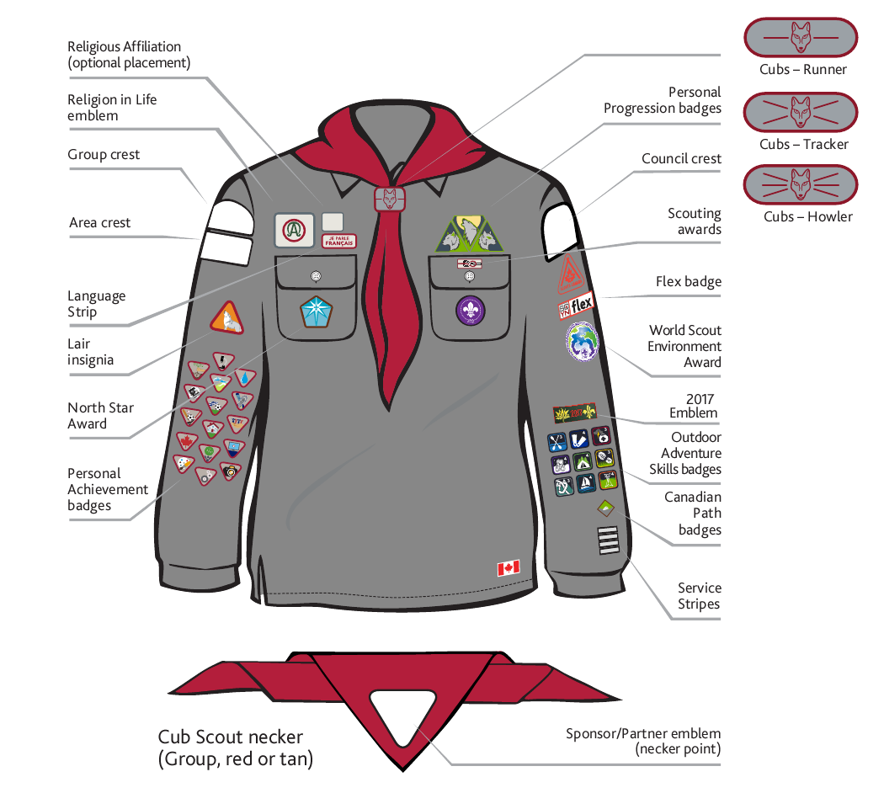
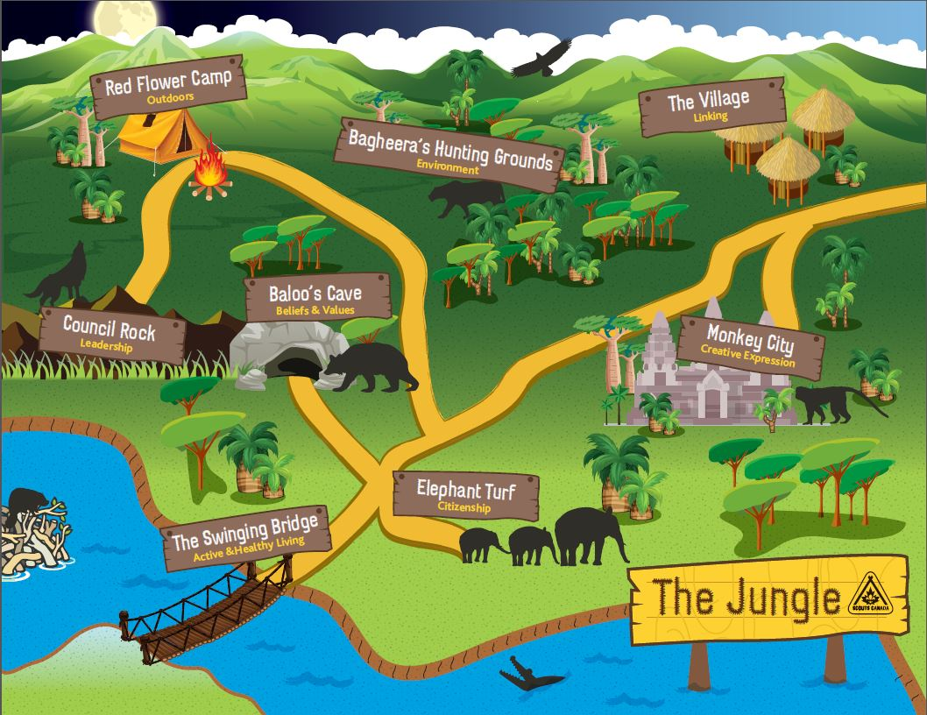
Promise:
I promise to do my best,
To love and serve God, to do my duty to the Queen;
To keep the law of the Wolf Cub pack,
And to do a good turn for somebody every day.
Alternative:
I promise to do my best, To be true to myself, To do my duty to my country; To keep the law of the Wolf Cub Pack, And to do a good turn for somebody every day.
Law:
The Cub respects the Old Wolf,
The Cub respects himself/herself.
We teach about DYB (Do Your Best), introduce responsibility, peer teaching and foundations of planning.
Your Cub Scout is part of a Cub Pack. Each pack is broken up into small groups called lairs. Each Lair has an “elected” Cub (usually 3rd year youth) who helps the Lair, along with the Scouters.
Motto:
Do your best.

Slide 10
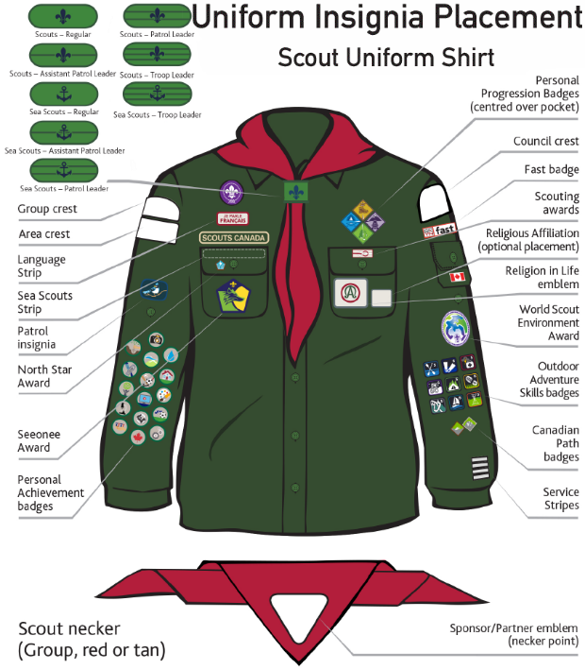
Promise:
On my honour
I promise that I will do my best
To do my duty to God and the King;
To help other people at all times,
And to carry out the spirit of the Scout Law.
Alternative option: On my honour; I promise that I will do my best, To respect my country and my beliefs, To help other people at all times; and to carry out the spirit of the Scout Law.
We teach more independence, get more into planning, leadership and adventure.
Your Scout is part of the Scout Troop. The troop is broken up into small groups called Patrols. Each Patrol has an “elected” Scout (usually 3rd year Scout (patrol Leader) to help guide them, along with the Scouters.
Motto:
Be Prepared!

Slide 11
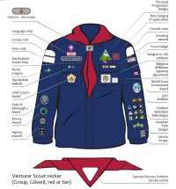
Promise:
On my honour
I promise that I will do my best
To do my duty to God and the King;
To help other people at all times,
And to carry out the spirit of the Scout Law.
Alternative option: On my honour; I promise that I will do my best, To respect my country and my beliefs, To help other people at all times; and to carry out the spirit of the Scout Law.
Motto:
Challenge!
Learning to work together as a “Company”.
Your Venturer Scout is part of his or her “Venturer Company”. The Company will “elect” an executive from their members, to help guide them through the year.
Positions include, a president, VP, Secretary, Treasurer, quartermaster, etc.

Slide 12
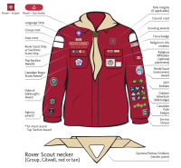
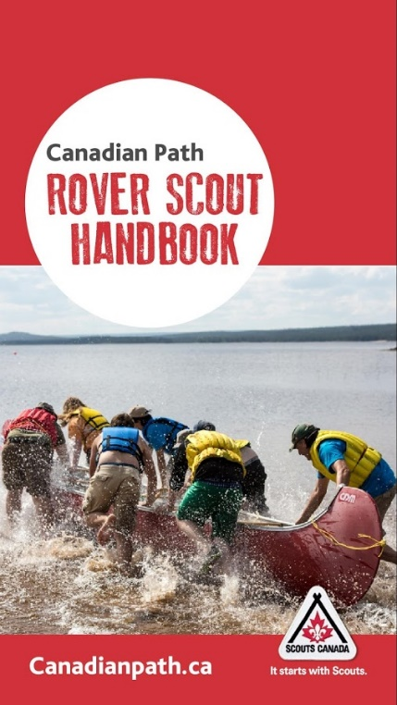
Promise:
On my honour
I promise that I will do my best
To do my duty to God and the King;
To help other people at all times,
And to carry out the spirit of the Scout Law.
Alternative option: On my honour; I promise that I will do my best, To respect my country and my beliefs, To help other people at all times; and to carry out the spirit of the Scout Law.
Learning to use self-discovery, adventure and abilities to progress through young adulthood under the metaphor of “paddle your own canoe”.
Rover groups are called a “Crew”. Each Crew will “elect” an executive to help them function and plan through the year. Positions include, Mate (“lead youth”), Scribe (Secretary), Treasurer, etc.
Motto:
Go Beyond!

Slide 13
What can you and your child expect in <Group> <Section>?
We have a fun-filled year planned!
Activity | Date/Time

Slide 14
What do we have planned as a Group?
All section events are a great way for younger youth to link up with older sections and see what they can expect when they ‘swim up’
Activity | Date
Holiday party
Out-of-the-cold supper
Baden Powell Dinner
Garden Supply fundraiser
All-section camp
End of year BBQ

Slide 15
<Group> Website

Slide 16
Scout Tracker (optional)

Slide 17
How we fundraise
Program fees help to support our Group and the scouting movement we need to fundraise to make our adventures that more much amazing
Scout Popcorn
Our national fundraiser that runs from September through October
Scout Popcorn offers a variety of delicious popcorn and a 45% return to Groups on all products
Apple Day
This is annual fundraiser provides our Scouting youth with an opportunity to show their appreciation to the community for their support throughout the year.
Our youth distribute apples as a way of saying “Thank You” to the community.
Scout Coffee / Scout Seeds
New partnerships with Equator Coffee Roasters and Make it Sow have enabled us to offer new contact-less ONLINE fundraisers to support Groups in creating great programming that fosters youth well-being and development.

Slide 18
Our Culture of Safety
Ranking of Activities
Category 1, Green - (go carefully) The majority of ‘normal’ Scouting activities would, in most instances, fall into this category; for example: weekly meetings in a school or church hall, supervised fire-lighting, knife-permit training, indoor bouldering and climbing (using auto-belay systems), swimming in a lifeguarded pool, bicycling, etc.
Category 2, Yellow - (proceed with caution) Outdoor activities as part of a regular meeting with higher risk activities, or of an extended nature, up to and including short-term camping outings of two nights or fewer. Category 3, Red - (be alert, check things carefully before proceedingOutdoor activities requiring specialized skills, or outings of three or more nights.
Safe and Happy Meetings
Even week to week at regular meeting we have rules and practices that keep everyone safe.
This includes things like…
Youth can’t be in sock feet at meeting halls, so that we prevent slips, trips and falls.
Ratio – at no time can the youth to adult ratio be greater than 8:1.
There must always be 2 Scouters present with youth at all times.
Behind every overnight outing and activity, there is a team of volunteers and staff who:
Have submitted a safety plan.
Gotten approval from Group committee or higher.
Checked on insurance.
Printed up to date forms for each youth and scouter.
Safe Scouting
We have a department at our national office which is specifically dedicated to Safe Scouting.
Safe Scouting guides volunteers and staff through Safety reviews anytime a complaint, concern or incident, is reported.

Slide 19
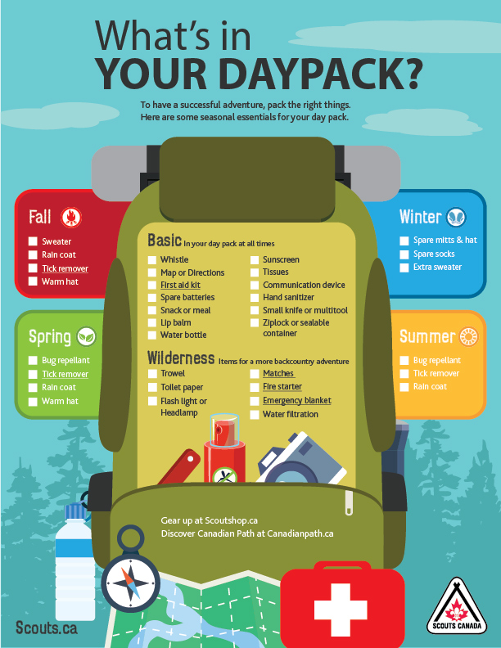
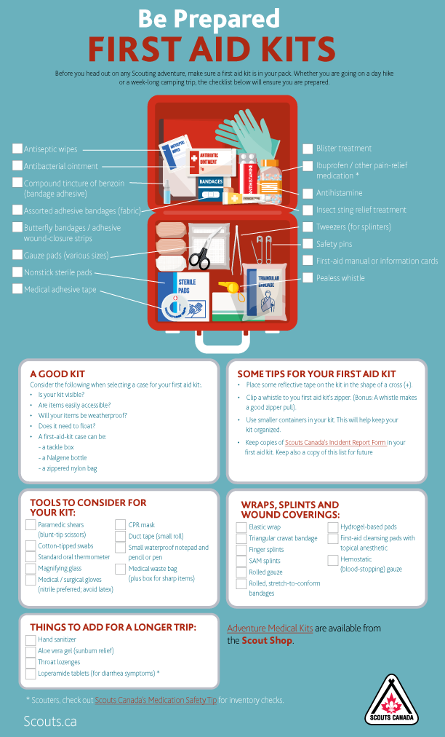
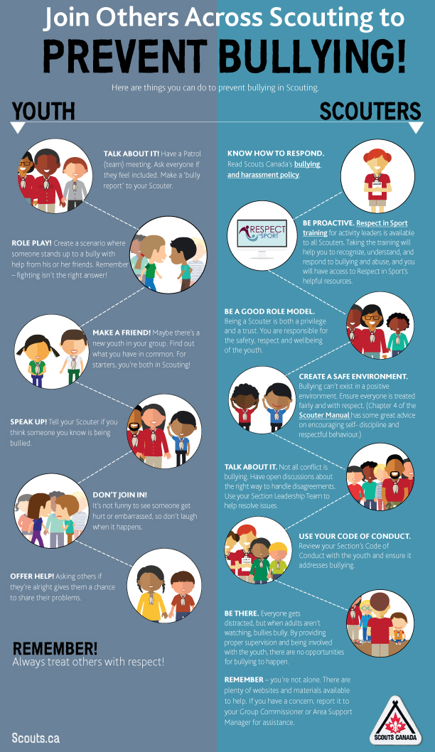
How we lead a culture of safety
By embedding safety in everything we do, we create a culture of safety supported by comprehensive policies, resources and guidelines for all Scouting activities.
2-Scouter rule
Ratio – 8:1
Transportation Policy

Slide 20
Unique Experiences and opportunities for youth
Leadership, scholarships and international adventures
Youth Leadership Experience
We offer Youth Leadership Training courses for all five Sections
The important job of these well-chosen young leaders is to be the voice of the youth, making sure that the opinions of those that we are here for, is enveloped into every program we run and everything we do.
Scholarship program
The Scouts Canada Scholarship Program provides financial support to members of Scouts Canada entering or continuing in full-time studies at Canadian universities or colleges.
All recipients are motivated youth whom, with the help of their Scouting experiences, have demonstrated outstanding leadership qualities and a desire to create a better world.
International experiences
Pen Pal opportunities to engage with scouting youth from around the world
International events like Jamborees and exchanges provide opportunities for experiencing another country and culture

Slide 21
Volunteering with Scouts Canada
Rediscover adventure and be part of your child’s Scouting experience!
Many people are looking for ways to develop skills that help them achieve personal and professional goals. Scouting has a long tradition of providing such opportunities.
Scouts Canada also offers excellent volunteer development courses
It’s a great way to get outdoors and experience outdoor spaces in your community
<Group> are seeking help with
Parent helpers
Administrator
Section scouters
Organization/logistics
Fundraising and marketing
Graphic design
Subject matter experts in STEM, environment, art, sports and beyond!

Slide 22
How we prepare our Scouters
PRC and VSS
Sign our Code of Conduct
Attend an Interview with two trained Scouters (volunteers)
Reference checks
Scouting Fundamentals Training
Will provide background on Scouting terms and program
RESPECT training for activity leaders
Many sports clubs include this in their onboarding training
Continuous feedback and support

Slide 23
Wood Badge I
This is the Level I Scouter training which prepares our volunteers for working with the youth in the Scouting Program.
Training can be done online in your own time or completed with a mentor
Learnings include, but are not limited to:
Canadian Path Fundamentals.
How to Plan for youth-led
What is your role in all of this?
How to take youth camping
What is STEM?
Understanding personal progression.
How to facilitate a balanced program.

Slide 24
Links and Resources
New Scouter welcome Kit - http://www.scouts.ca/wp-content/uploads/scouters/NSWK.pdf
No One Left Behind Subsidy Program - https://www.scouts.ca/programs/no-one-left-behind.html
Thanks button - http://www.scouts.ca/thanks/
Canadian path program guides and personal growth plans (all sections)
https://www.scouts.ca/programs/sections/beaver-scouts.html
https://www.scouts.ca/programs/sections/cub-scouts.html
https://www.scouts.ca/programs/sections/scouts.html
https://www.scouts.ca/programs/sections/venturer-scouts.html
https://www.scouts.ca/programs/sections/rover-scouts.html
Outdoor Adventure Skills Badges – Competencies and Requirement -
https://www.scouts.ca/programs/sections/outdoor-adventure-skills.html
Volunteer Information link - https://www.scouts.ca/volunteer/overview.html
Uniforms/scout shop - https://www.scoutshop.ca/
Program quality & seasonal guidelines (all sections) - https://www.scouts.ca/resources/group-support-centre/program-quality.html
Scouter’s Manual - https://www.scouts.ca/f/1iwuo
Safe Scouting - http://www.scouts.ca/safety/

