Slide 1
SCOUTSTRACKER Overview For Group Commissioners
January 2020
Topics
View Sections Accounts & Schedules
Push Group Schedule events to Sections
Email – Sections/Scouters/Parents
PRC Report/Information
Adventure Application Forms

Slide 2
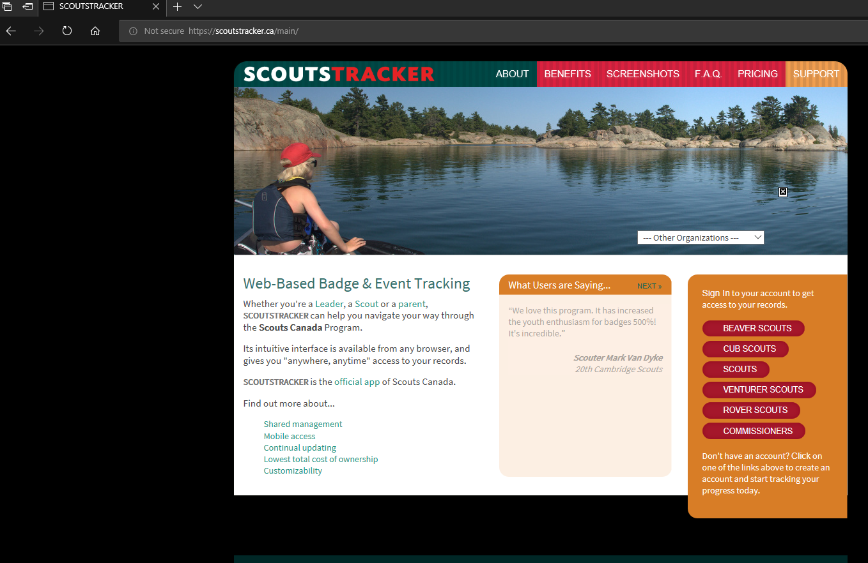
Launch and Login Screen https://scoutstracker.ca/sc/info/

Slide 3
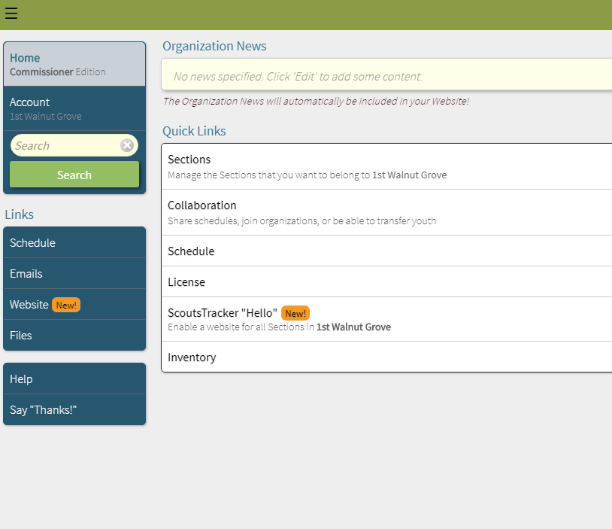

Slide 4
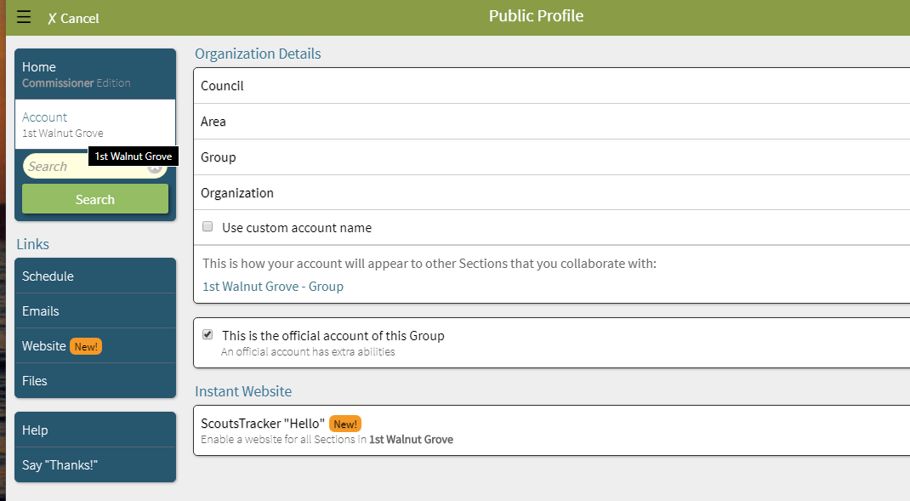

Slide 5
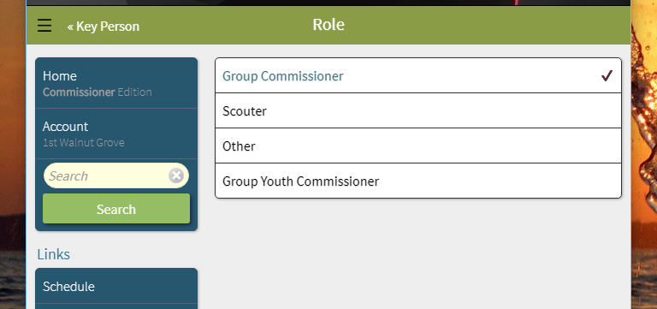
One of the Key Person needs to have the Group Commissioner Role

Slide 6
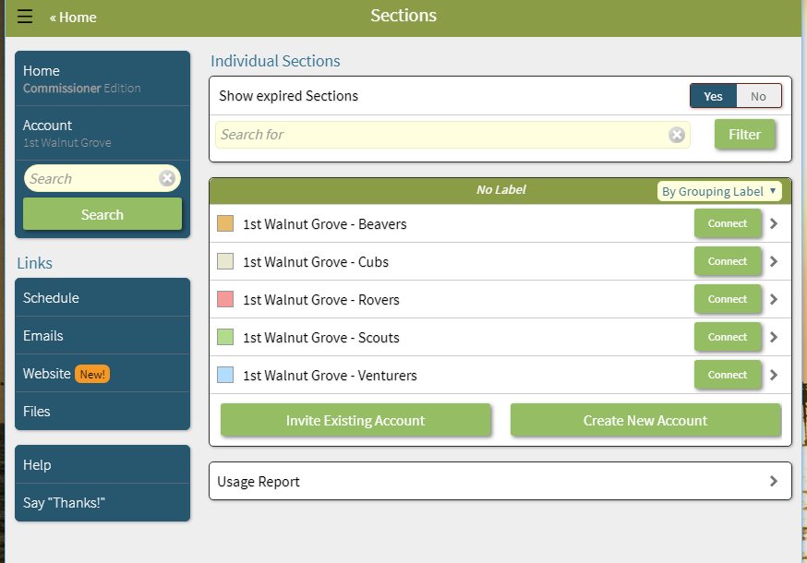

Slide 7
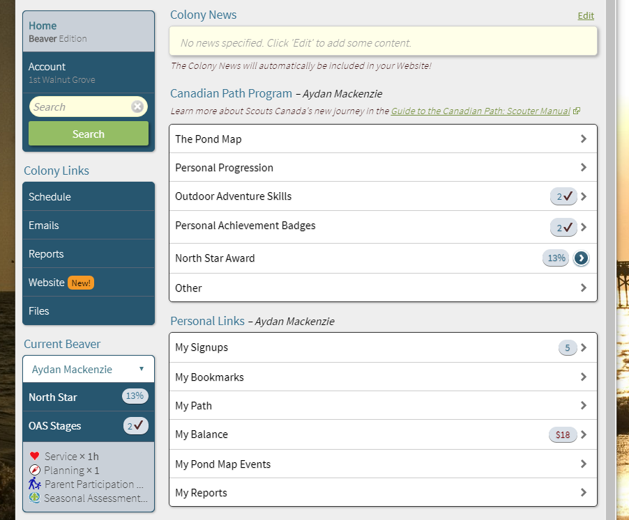

Slide 8
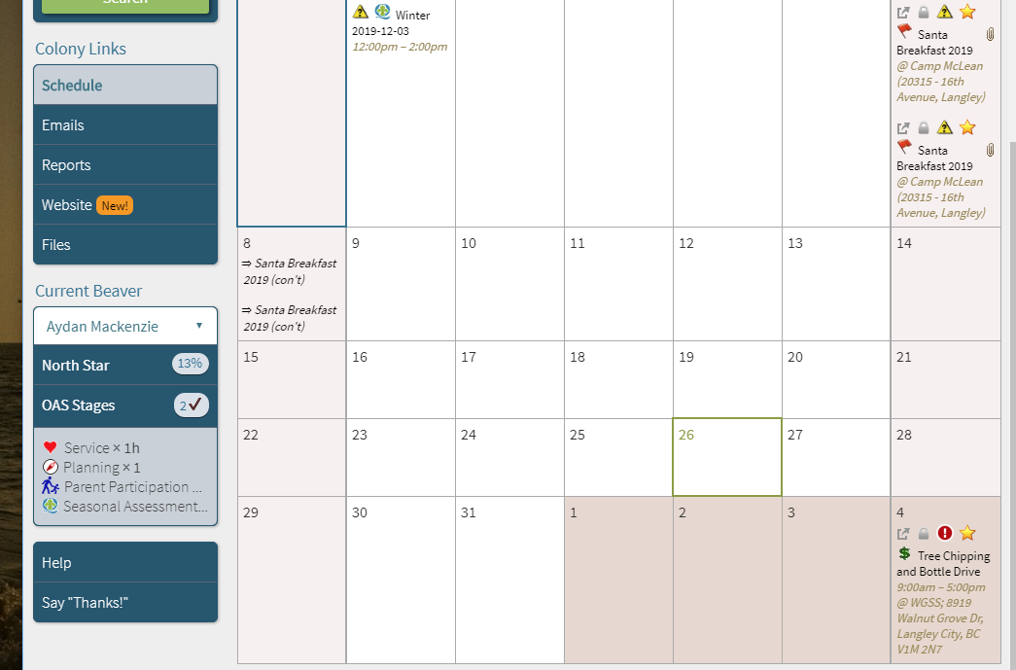
Section Schedule - Colony
Event came from
Group Schedule

Slide 9
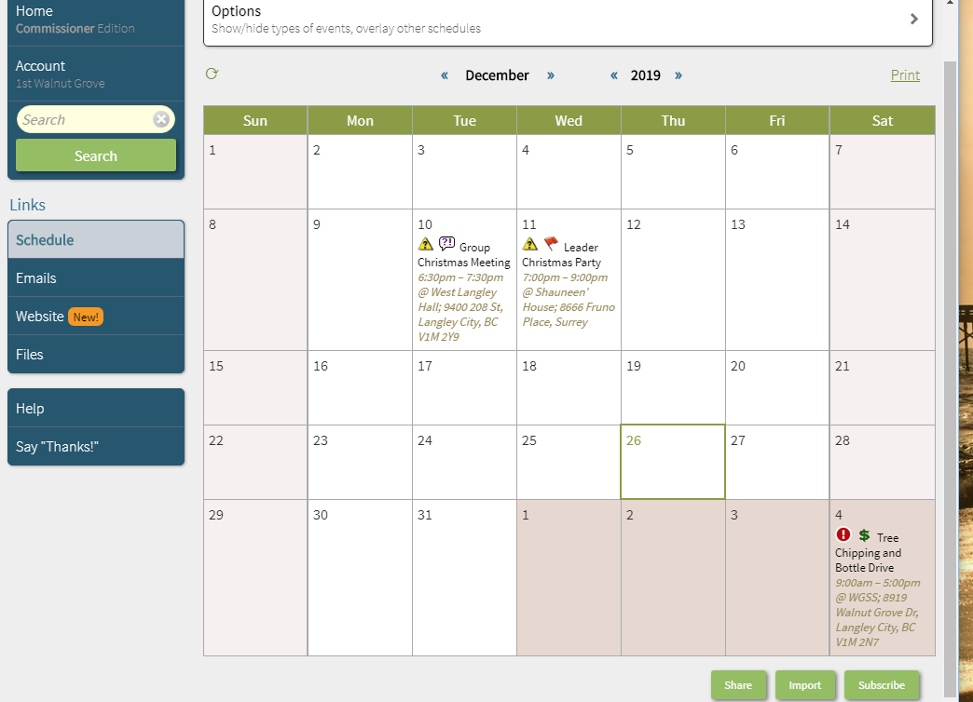
Group Schedule
Event pushed to
Section Schedules

Slide 10
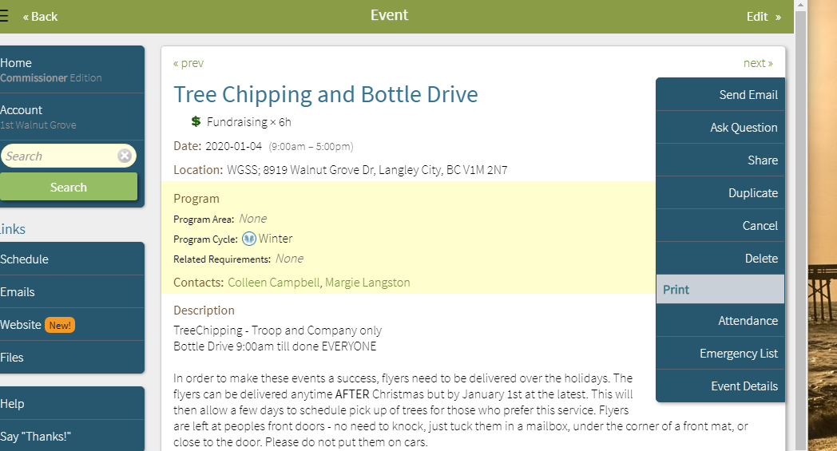
Send Event
To Sections

Slide 11
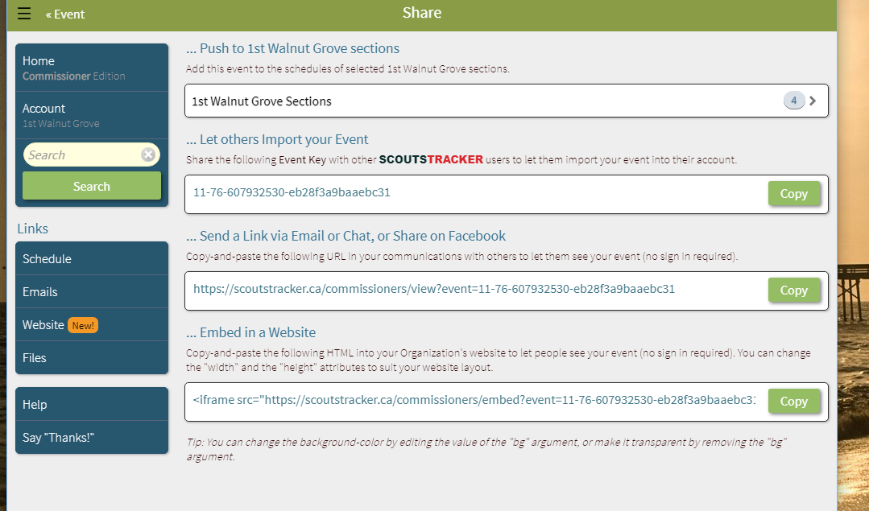

Slide 12
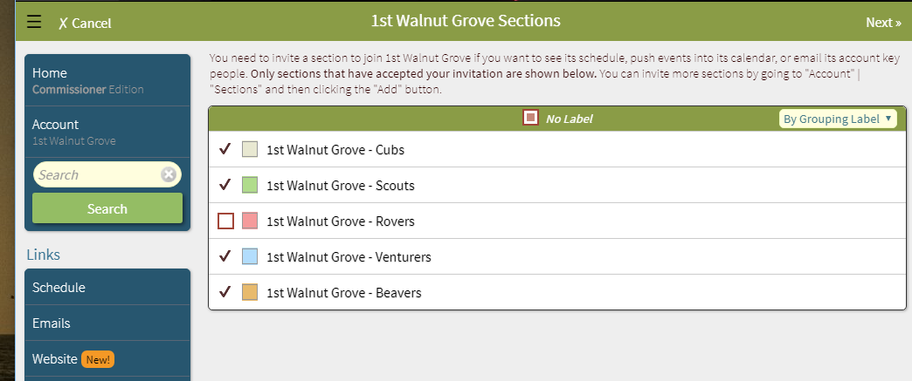

Slide 13
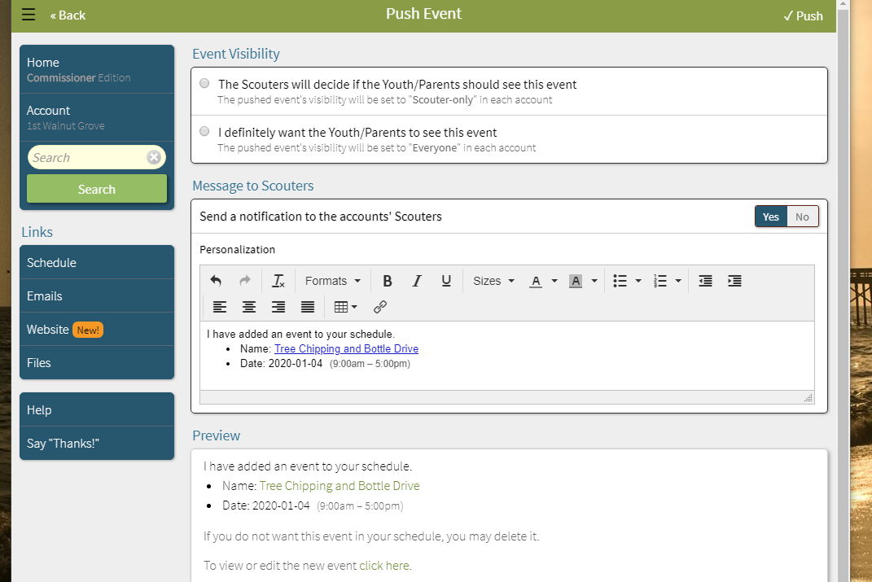

Slide 14
General Emails
Use Schedule/Send Email for email related to a specific event

Slide 15
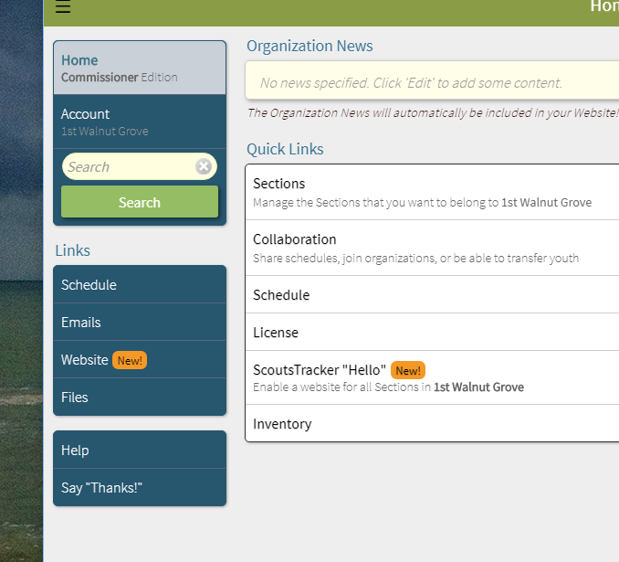

Slide 16
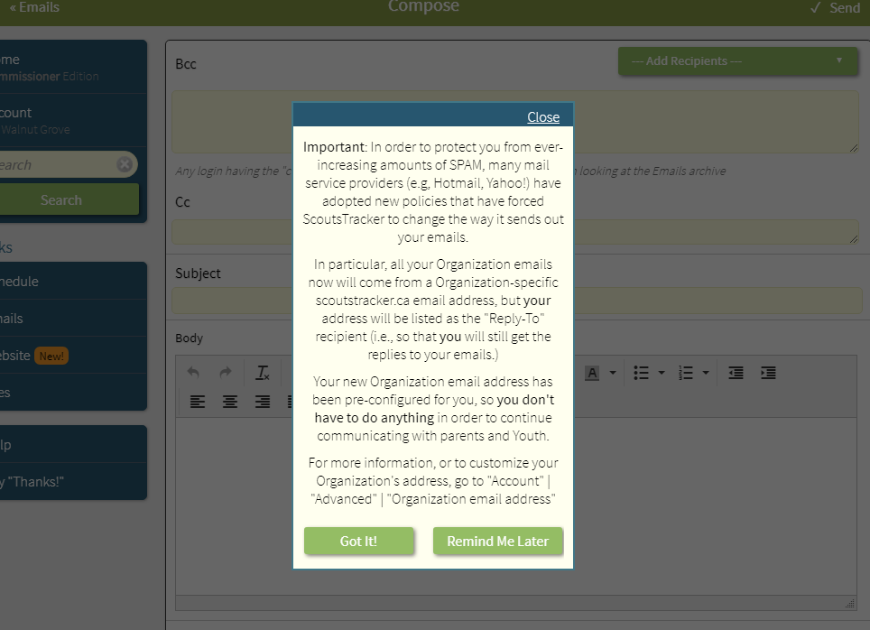

Slide 17
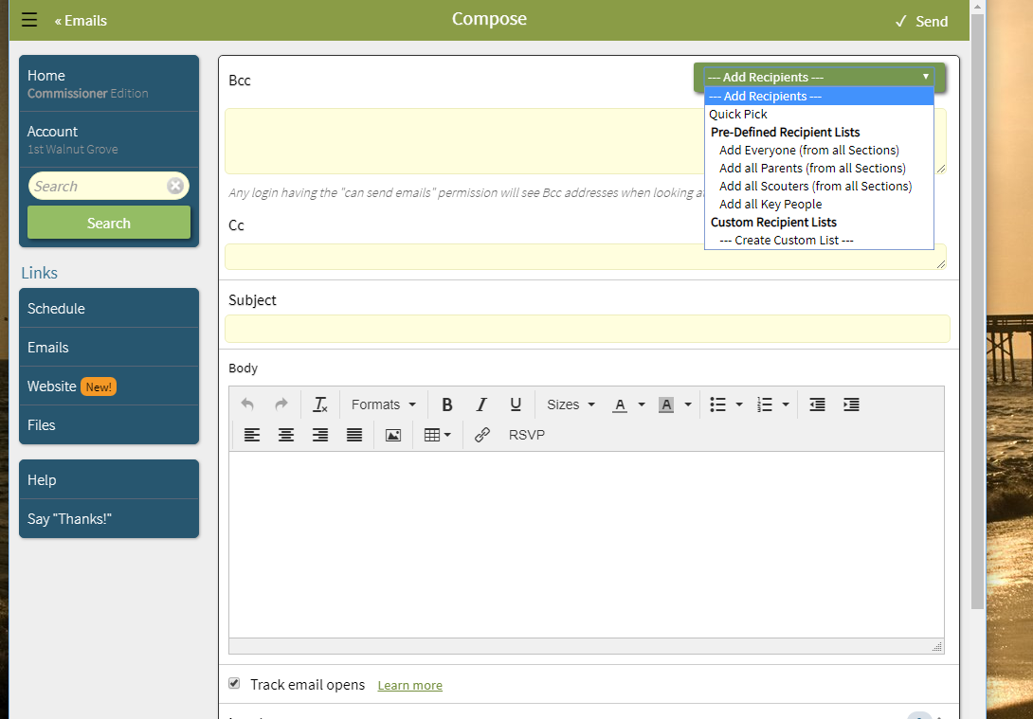

Slide 18
PRC Report

Slide 19
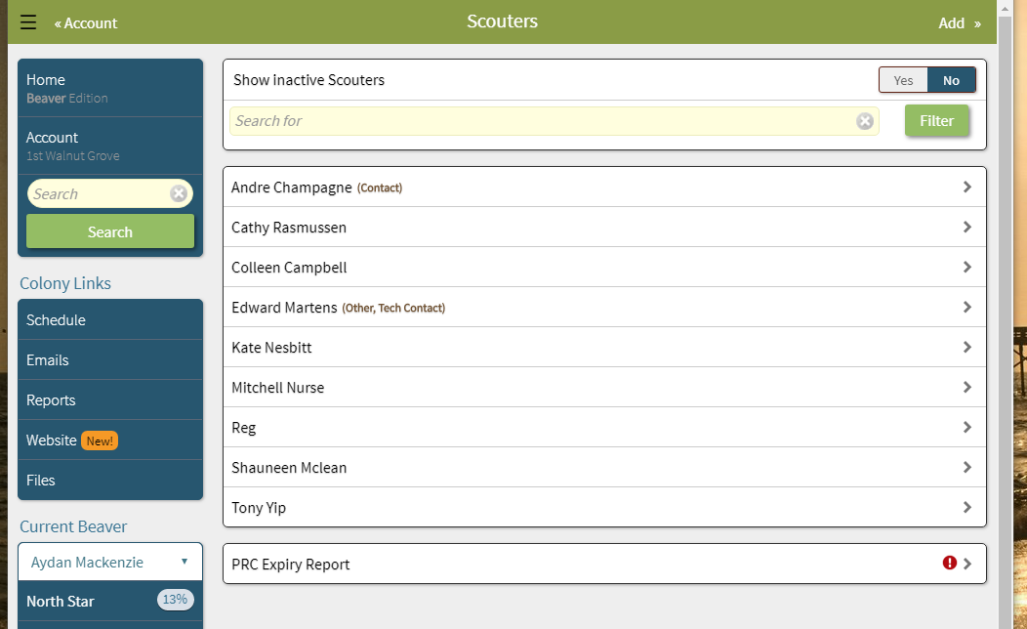

Slide 20
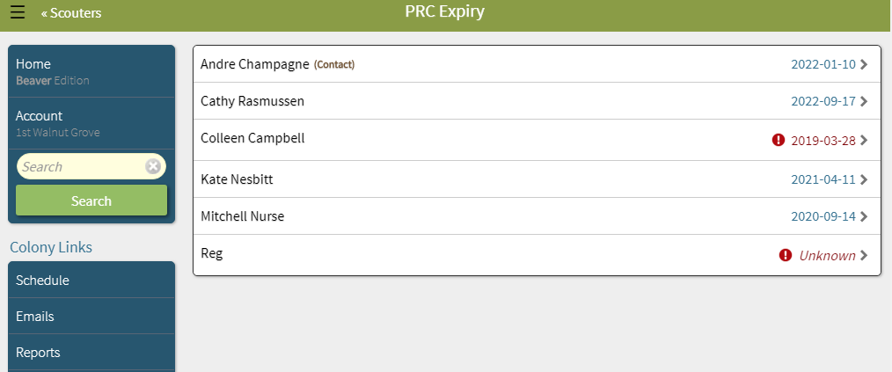
PRC Report only lists PRC information for Scouters that have a role in the section and were
Imported from MyScouts.

Slide 21
Adventure Application Forms [AAF]

Slide 22
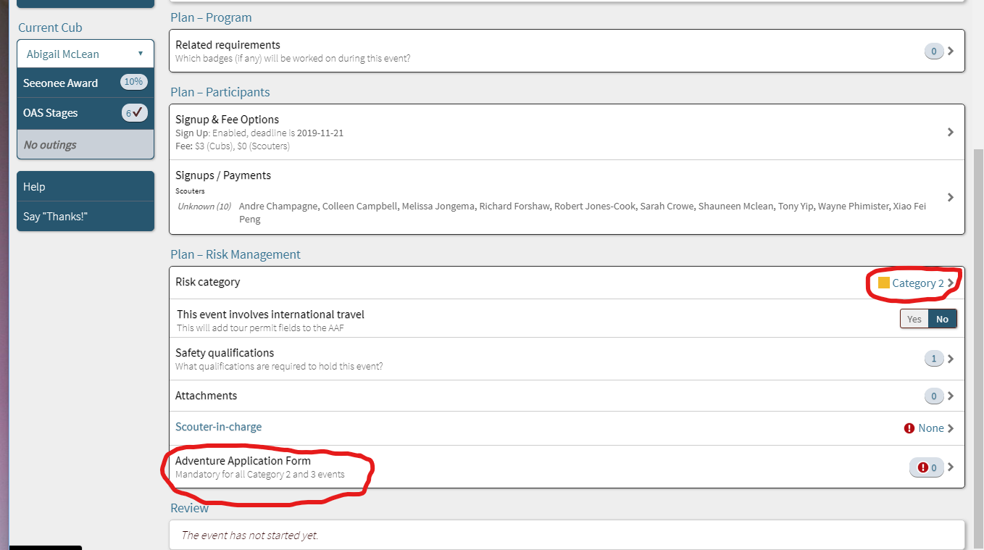
Edit scheduled event – select Adventure Application Form near bottom of screen

Slide 23
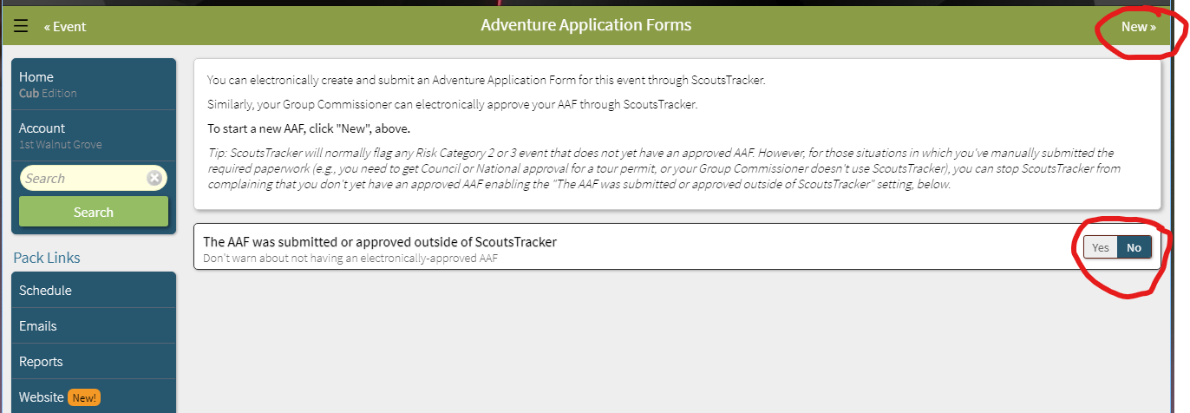
https://scoutstracker.ca/cubs/view?event=0-494-846861365-62151bee02cad391

Slide 24
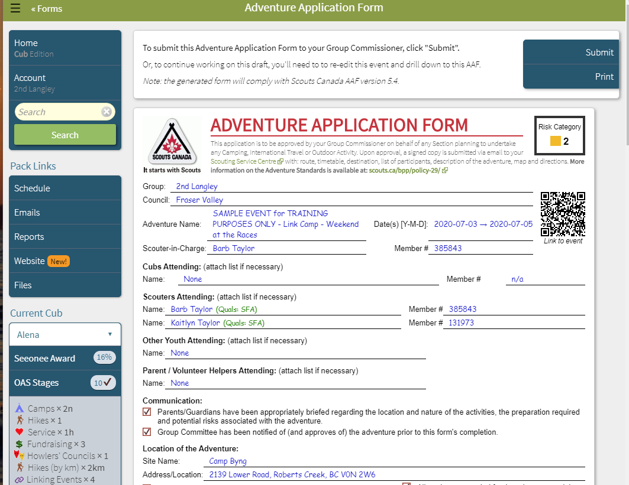

Slide 25
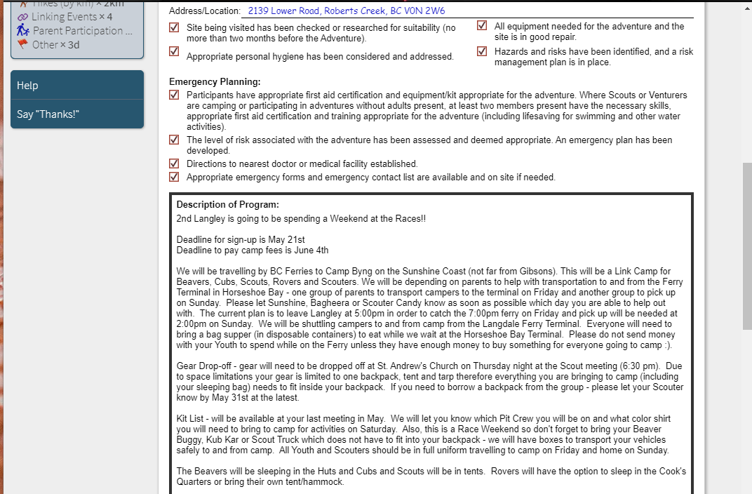

Slide 26
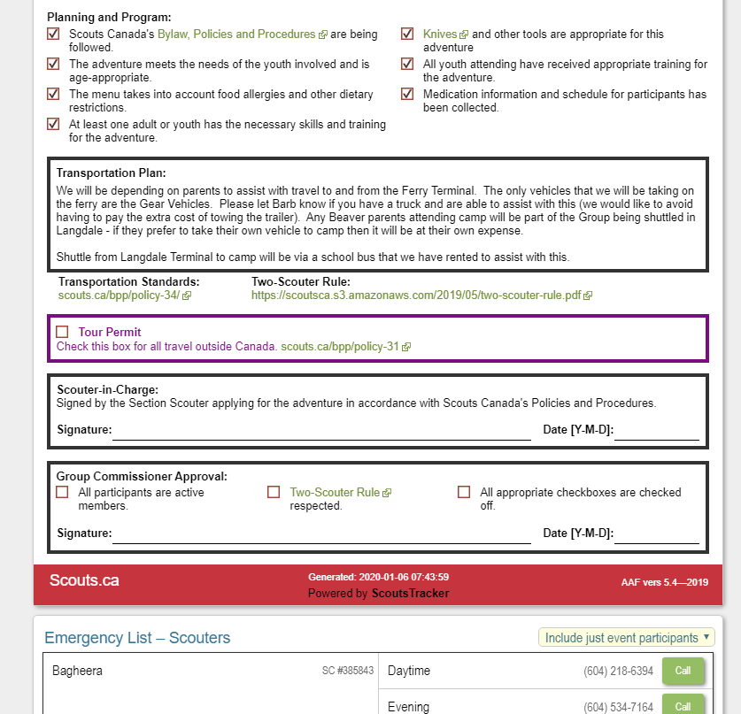

Slide 27
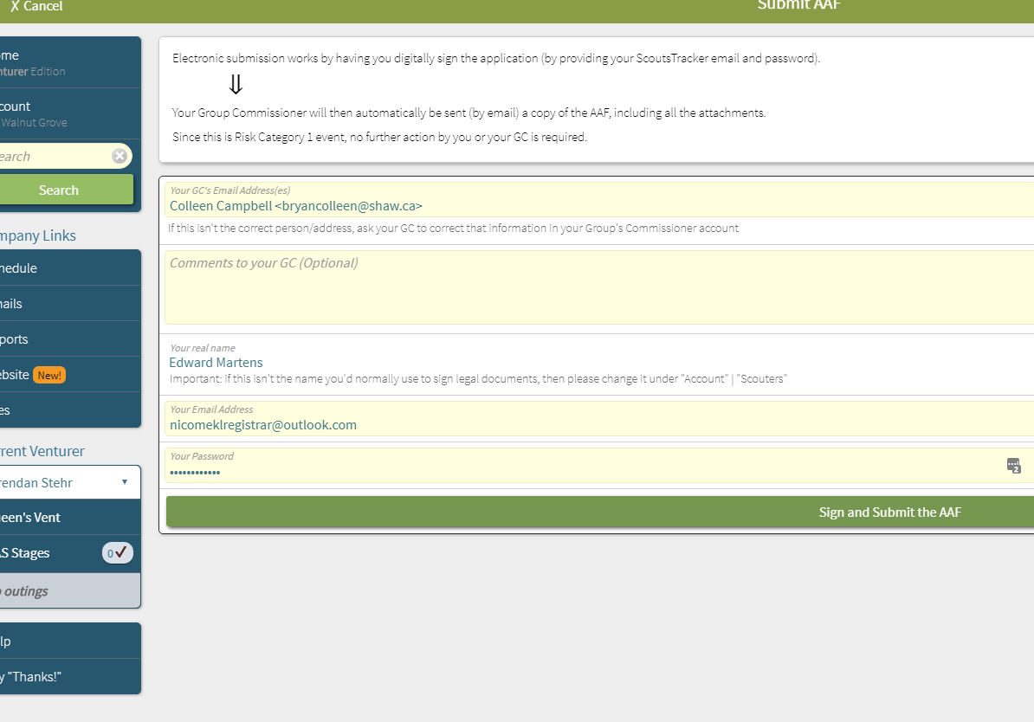

Slide 28
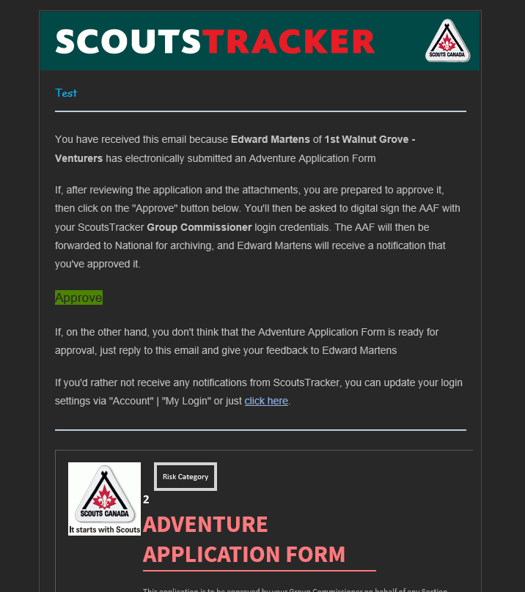

Slide 29
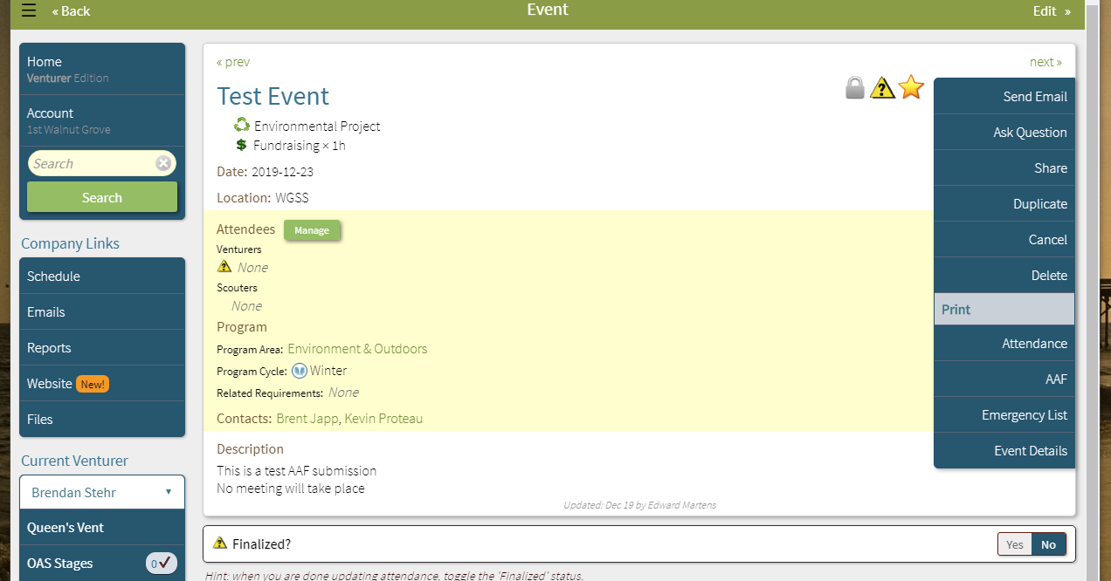

Slide 30
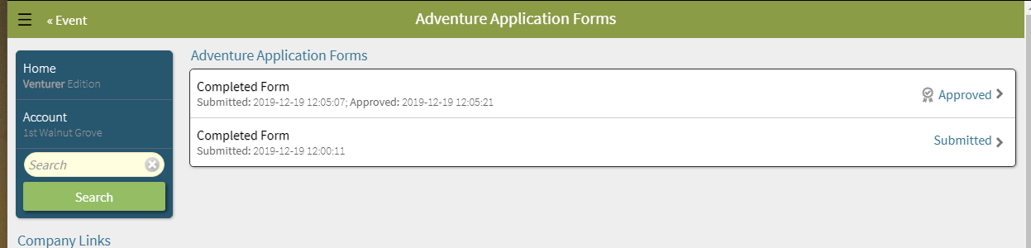

Slide 31
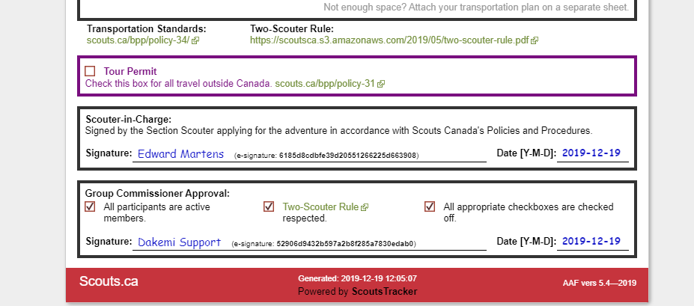

Slide 32
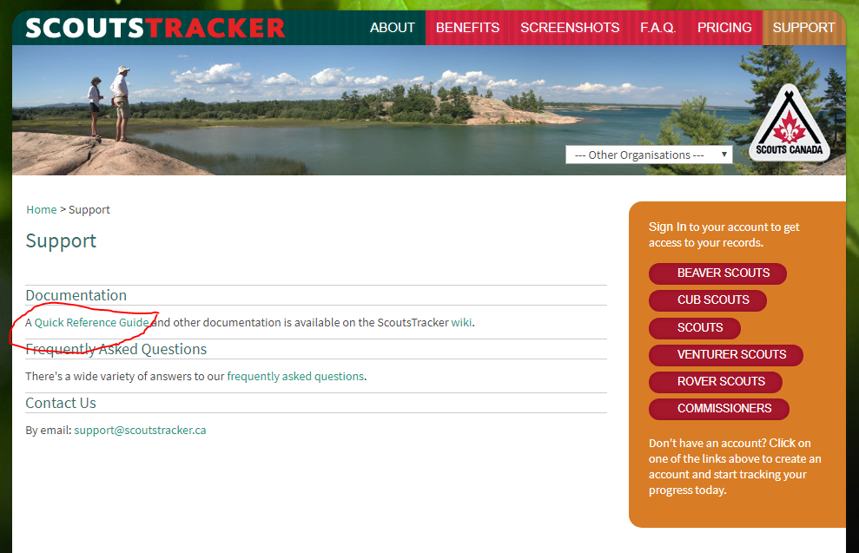

Slide 33
