Slide 1
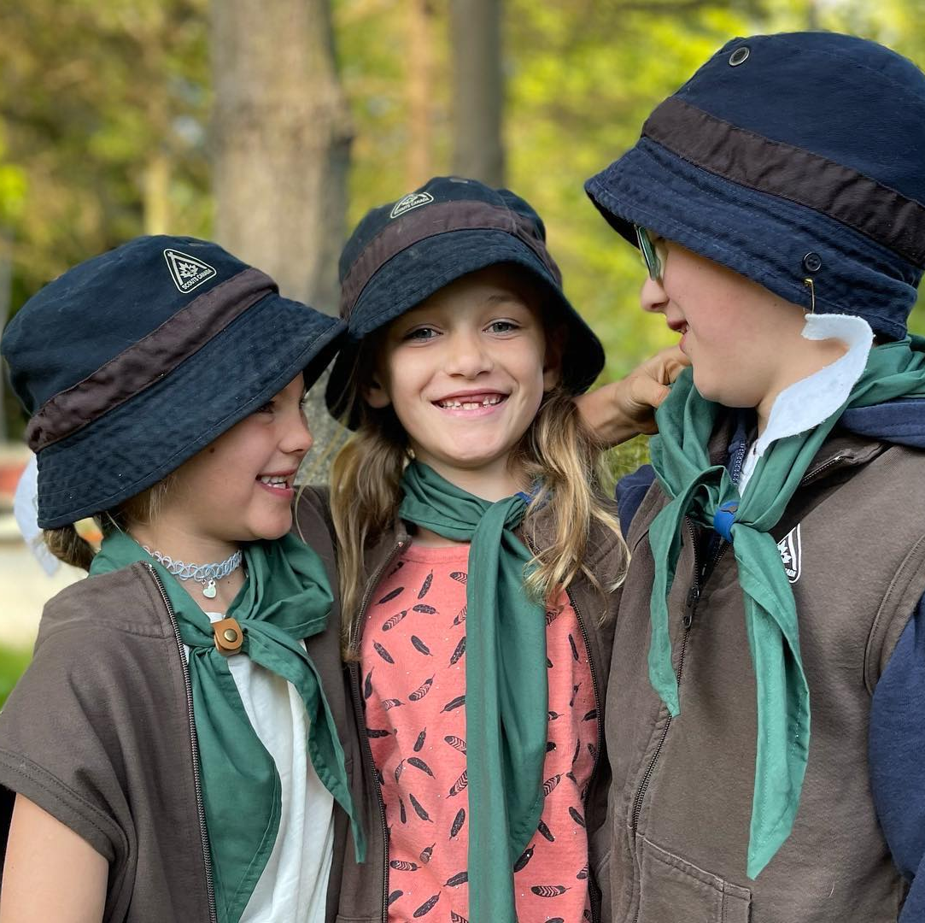

Welcome to our Open House
Council information here.

Slide 2
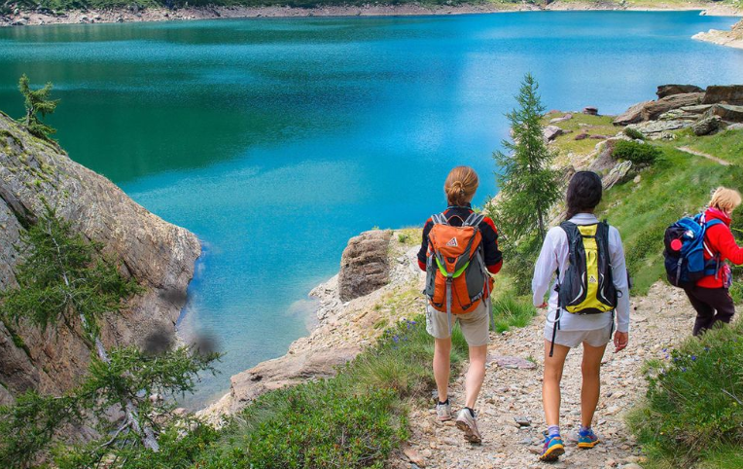
Scouts Canada
Our Mission
To help develop well-rounded youth, better prepared for success in the world.
Our Vision
Canadian youth making meaningful contribution to creating a better world.
THE CANADIAN PATH – YOUTH LED
The Canadian Path is the way Scouting is done in Canada. Through this program, Scouts pave their own path to outdoor adventure and fun by setting their own goals, creating organized plans to achieve these goals, and collectively reflecting on their experiences and personal development. Youth leadership is one of the many ways that the Scouts Canada program helps youth develop into critical thinkers and team players, better prepared for success in the world. Among the programs that allow youth to build on their leadership skills include the Youth Spokesperson Program and the Youth Leadership in Training Program.

Slide 3
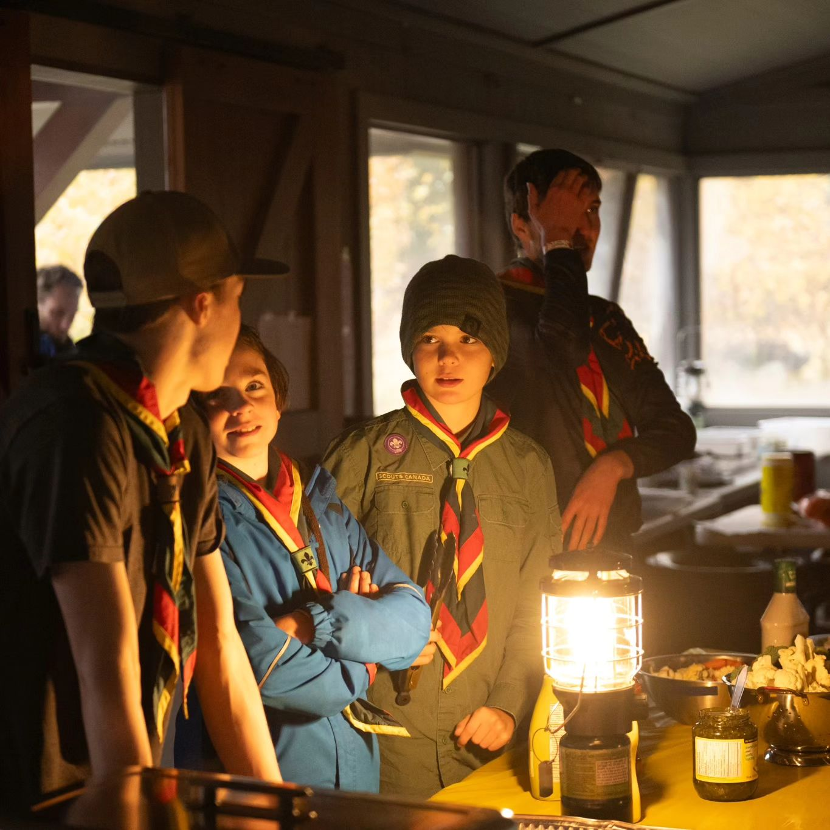
Why Scouts
Explain Scouting’s benefits for families
Something fun for parents to do with
their children that is active.
Youth are less shy.
Youth do better in school.
Youth develop their leadership skills
and gain self-confidence.
It’s a dynamic program that promotes youth and young adults working together.

Slide 4
The Scouting Method
Scout Law and Promise
Learning by Doing
The Team System
A Symbolic Framework
Nature
Personal Progression
Adult Support
Community Involvement
We do this through;
The outdoors
Small Groups
Youth leadership and decision-making at all levels.
Programs that build on each other.
A uniform
A promise, law and motto
Under the supervision of adult leaders.

Slide 5
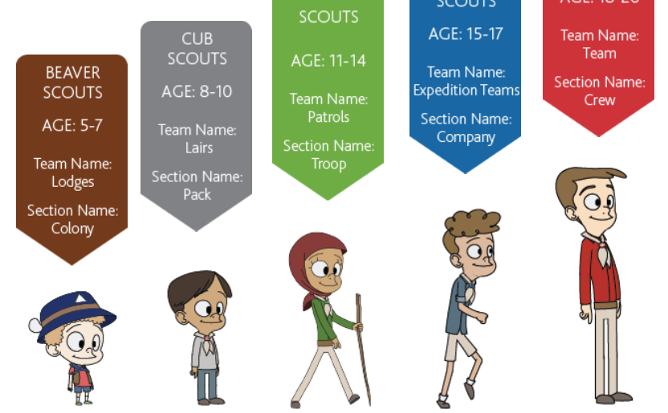
What does a (Type of Section your opening) Look Like?

Slide 6
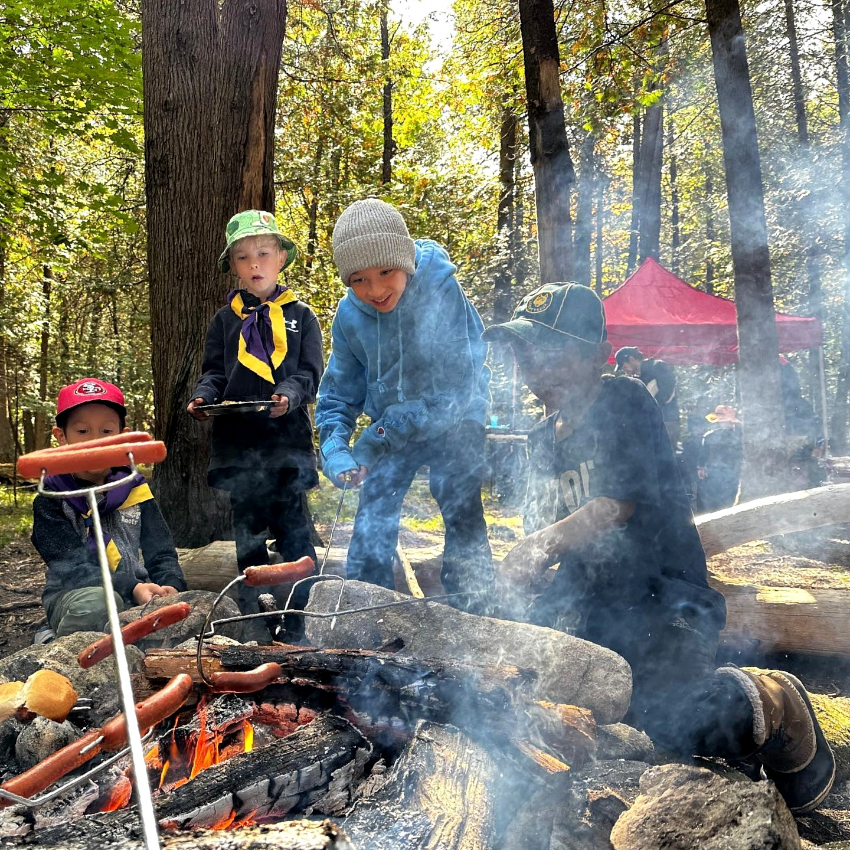
What does the Section look like.

Slide 7
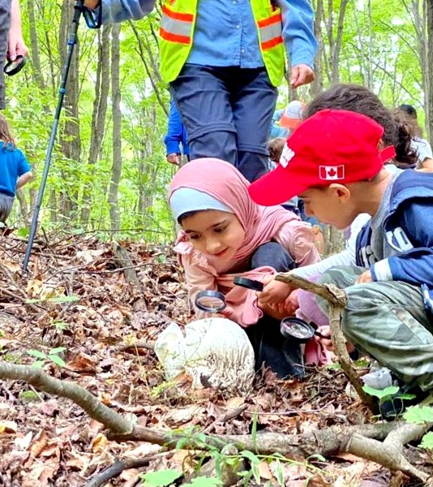
Camps and Activities
Provide examples that speak to your outdoor adventures and camps.

Slide 8
Parent Involvement
As much as possible, Scouting is a parent and child activity. Parents are expected to be involved.
01
The easiest and most fun way is to be a section leader – such as a Beaver, Cub or Scout leader.
02
You can also be involved on the fundraising committee or the Group Committee
03
Perhaps you’d like to plan a special event – ideally a group should have one of every month.
04

Slide 9
A Section Can’t run without Volunteers
What do you need?
Police Record Check with Vulnerable Sector Search
A reference check resulting in at least 3 passed references to become compliant
A signed Code of Conduct
Online learning
An Interview

Slide 10
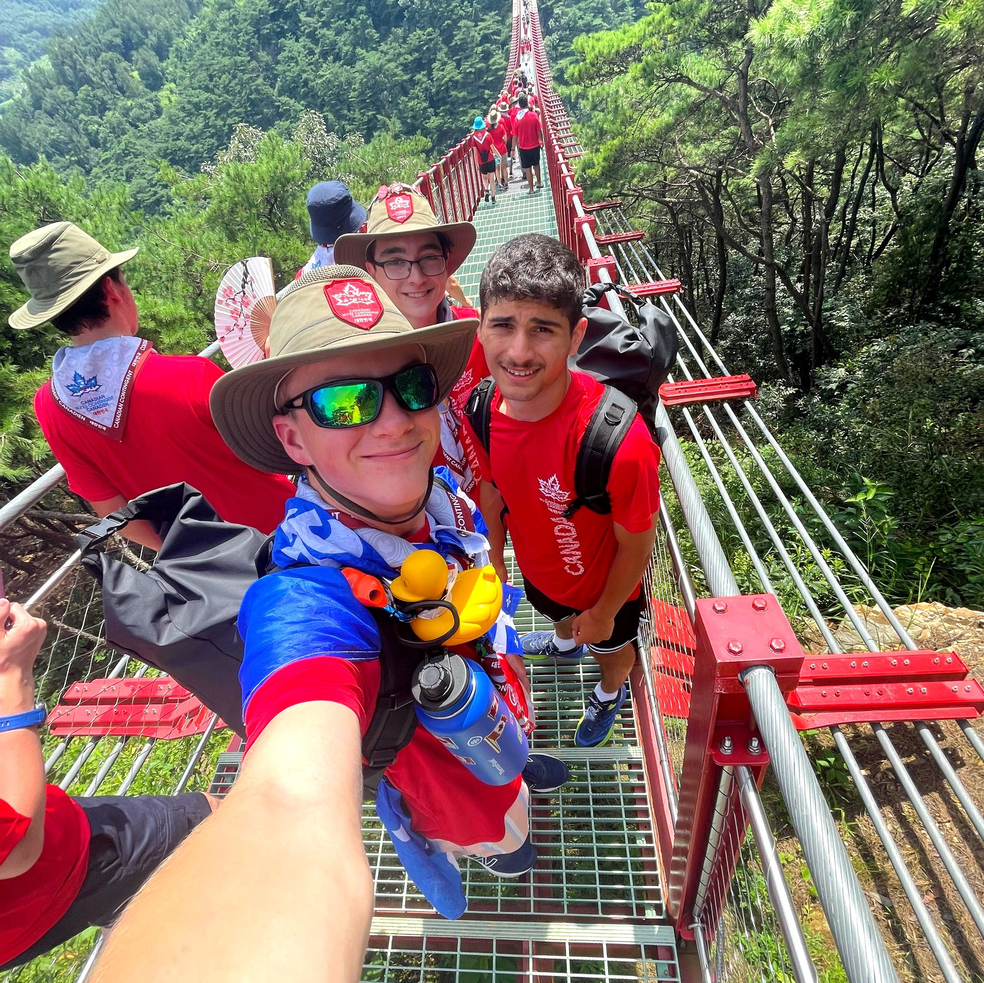
But I don’t have experience
No experience No problem!
Training is provided
Mentorship is provided
Online resources
Variety of Volunteer roles
Ongoing development opportunities

Slide 11
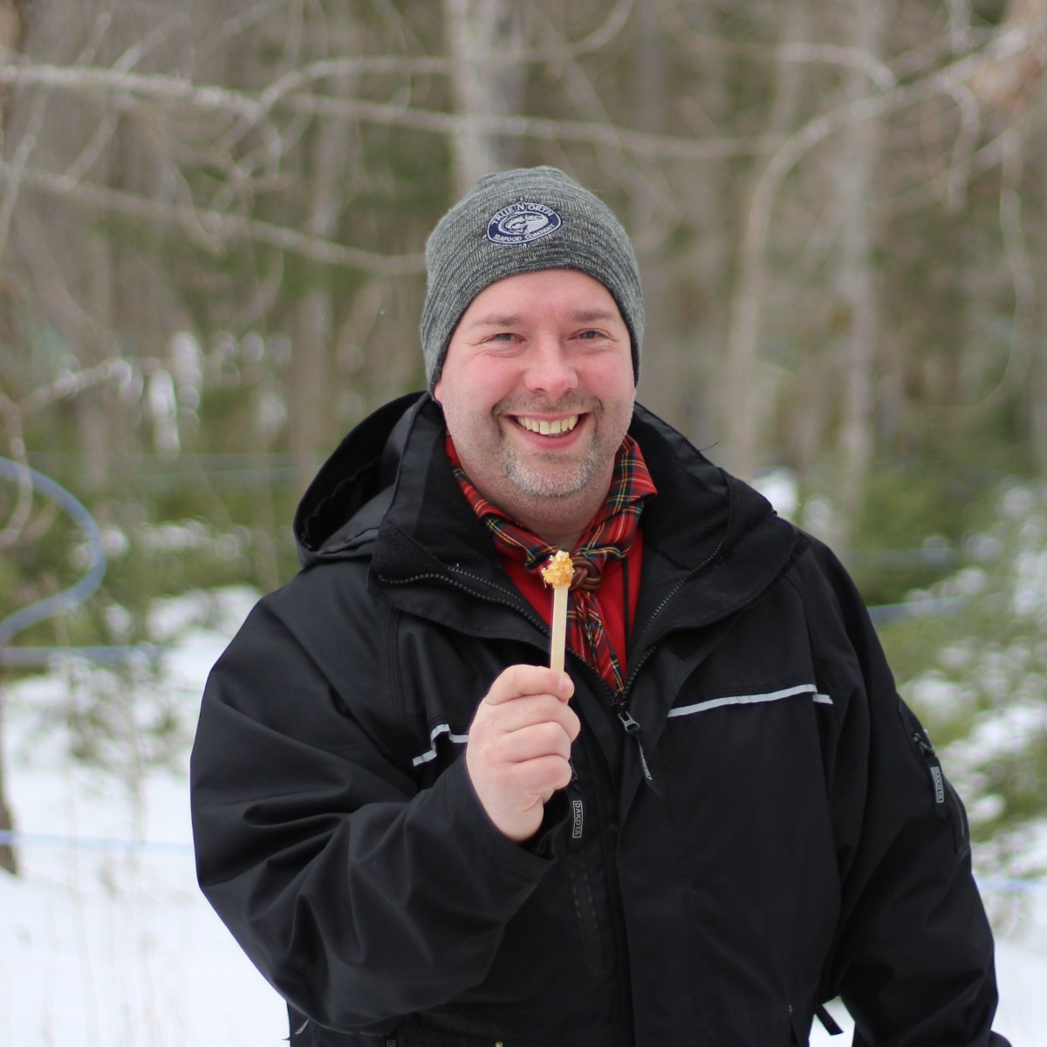
Join the experience and enjoy the benefits of volunteering with Scouts Canada:
Community – find a community of like-minded people.
Confidence – gain more confidence in your skills and self while building a world of resilient young Canadians.
Experience – make a difference while building your own experience.
Family – become part of our big family.
Fun – let your inner child play.
Health – develop a new positive outlook with us.
Inspiration – help shape Canada’s next generation of youth.
Skills – bring your talents to our team.
Say YES to kids and to yourself!

Slide 12
Sign up today!
Insert QR code here. Volunteer and kids.
Have a computer on site to sign parents up as well.

Slide 13
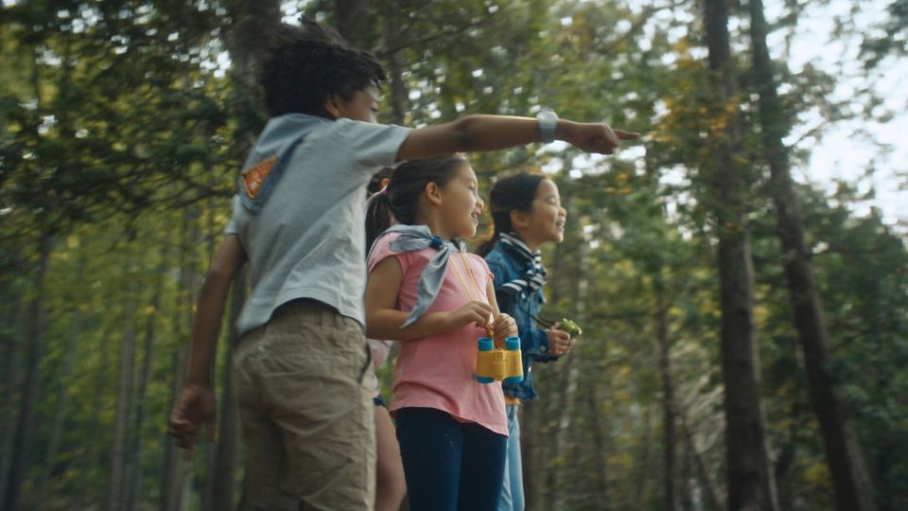
Questions?

Slide 14
Thank you
Add any other end comments this is where you should include a QR code handouts that you have to pass out etc.

